Slide 1

Refactoring Techniques

Slide 2
Composing Methods
Much of refactoring is devoted to correctly composing methods. In most cases, excessively long methods are the root of all evil. The vagaries of code inside these methods conceal the execution logic and make the method extremely hard to understand—and even harder to change.
The refactoring techniques in this group streamline methods, remove code duplication, and pave the way for future improvements.
Techniques:
Extract Method
Inline Method
Extract Variable
Inline Temp
Replace Temp with Query
Split Temporary Variable
Remove Assignments to Parameters
Replace Method with Method Object
Substitute Algorithm

Slide 3
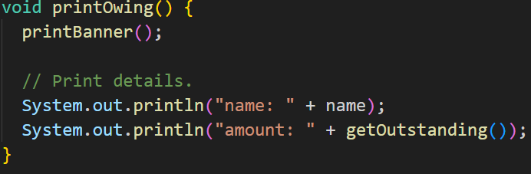

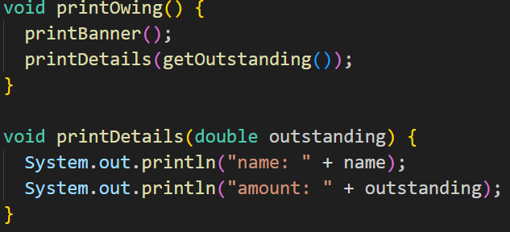
Extract Method
Problem: You have a code fragment that can be grouped together.
Solution: Move this code to a separate new method (or function) and replace the old code with a call to the method.

Slide 4
Extract Method
Why Refactor?
The more lines found in a method, the harder it’s to figure out what the method does. This is the main reason for this refactoring.
Besides eliminating rough edges in your code, extracting methods is also a step in many other refactoring approaches.
Benefits
More readable code! Be sure to give the new method a name that describes the method’s purpose: createOrder(), renderCustomerInfo(), etc.
Less code duplication. Often the code that’s found in a method can be reused in other places in your program. So you can replace duplicates with calls to your new method.
Isolates independent parts of code, meaning that errors are less likely (such as if the wrong variable is modified).

Slide 5
Extract Method
How to Refactor?
Create a new method and name it in a way that makes its purpose self-evident.
Copy the relevant code fragment to your new method. Delete the fragment from its old location and put a call for the new method there instead.
Find all variables used in this code fragment. If they’re declared inside the fragment and not used outside of it, simply leave them unchanged—they’ll become local variables for the new method.
If the variables are declared prior to the code that you’re extracting, you will need to pass these variables to the parameters of your new method in order to use the values previously contained in them. Sometimes it’s easier to get rid of these variables by resorting to Replace Temp with Query.
If you see that a local variable changes in your extracted code in some way, this may mean that this changed value will be needed later in your main method. Double-check! And if this is indeed the case, return the value of this variable to the main method to keep everything functioning.

Slide 6
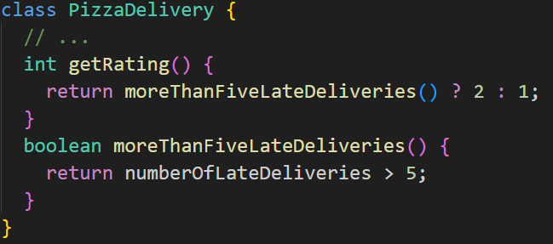
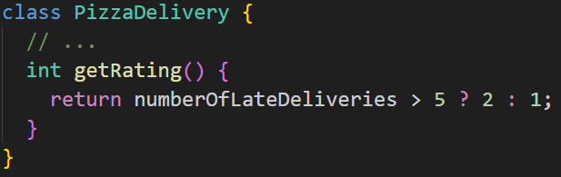
Inline Method
Problem: When a method body is more obvious than the method itself, use this technique.
Solution: Replace calls to the method with the method’s content and delete the method itself.

Slide 7
Inline Method
Why Refactor?
A method simply delegates to another method. In itself, this delegation is no problem. But when there are many such methods, they become a confusing tangle that’s hard to sort through.
Often methods aren’t too short originally but become that way as changes are made to the program. So don’t be shy about getting rid of methods that have outlived their use.
Benefits
By minimizing the number of unneeded methods, you make the code more straightforward.

Slide 8
Inline Method
How to Refactor?
Make sure that the method isn’t redefined in subclasses. If the method is redefined, refrain from this technique.
Find all calls to the method. Replace these calls with the content of the method.
Delete the method.

Slide 9
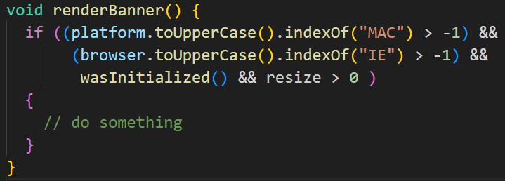
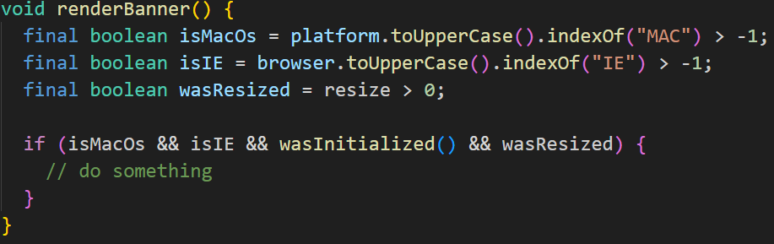
Extract Variable
Problem: You have an expression that’s hard to understand.
Solution: Place the result of the expression or its parts in separate variables that are self-explanatory.

Slide 10
Extract Variable
Why Refactor?
The main reason for extracting variables is to make a complex expression more understandable, by dividing it into its intermediate parts. These could be:
Condition of the if() operator or a part of the ?: operator in C-based languages
A long arithmetic expression without intermediate results
Long multipart lines
Extracting a variable may be the first step towards performing Extract Method if you see that the extracted expression is used in other places in your code.
Benefits
More readable code! Try to give the extracted variables good names that announce the variable’s purpose loud and clear. More readability, fewer long-winded comments. Go for names like customerTaxValue, cityUnemploymentRate, clientSalutationString, etc.

Slide 11
Extract Variable
Drawbacks
More variables are present in your code. But this is counterbalanced by the ease of reading your code.
When refactoring conditional expressions, remember that the compiler will most likely optimize it to minimize the amount of calculations needed to establish the resulting value. Say you have a following expression if (a() || b()) .... The program won’t call the method b if the method a returns true because the resulting value will still be true, no matter what value returns b.
However, if you extract parts of this expression into variables, both methods will always be called, which might hurt performance of the program, especially if these methods do some heavyweight work.

Slide 12
Extract Variable
How to Refactor?
Insert a new line before the relevant expression and declare a new variable there. Assign part of the complex expression to this variable.
Replace that part of the expression with the new variable.
Repeat the process for all complex parts of the expression.

Slide 13
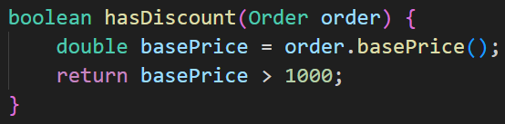
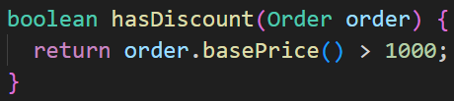
Inline Temp
Problem: You have a temporary variable that’s assigned the result of a simple expression and nothing more.
Solution: Replace the references to the variable with the expression itself.

Slide 14
Inline Temp
Why Refactor?
Inline local variables are almost always used as part of Replace Temp with Query or to pave the way for Extract Method.
Benefits
This refactoring technique offers almost no benefit in and of itself. However, if the variable is assigned the result of a method, you can marginally improve the readability of the program by getting rid of the unnecessary variable.
Drawbacks
Sometimes seemingly useless temps are used to cache the result of an expensive operation that’s reused several times. So before using this refactoring technique, make sure that simplicity won’t come at the cost of performance.

Slide 15
Inline Temp
How to Refactor?
Find all places that use the variable. Instead of the variable, use the expression that had been assigned to it.
Delete the declaration of the variable and its assignment line.

Slide 16
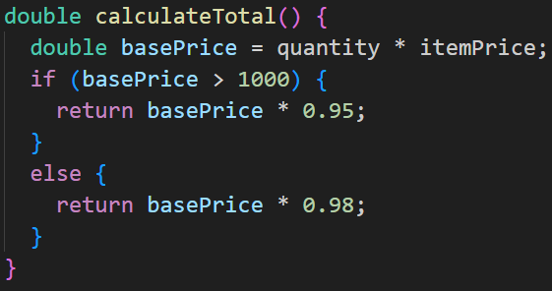
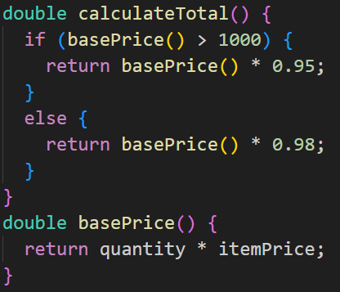
Replace Temp with Query
Problem: You place the result of an expression in a local variable for later use in your code.
Solution: Move the entire expression to a separate method and return the result from it. Query the method instead of using a variable. Incorporate the new method in other methods, if necessary.

Slide 17
Replace Temp with Query
Why Refactor?
This refactoring can lay the groundwork for applying Extract Method for a portion of a very long method.
The same expression may sometimes be found in other methods as well, which is one reason to consider creating a common method.
Benefits
Code readability. It’s much easier to understand the purpose of the method getTax() than the line orderPrice() * 0.2.
Slimmer code via deduplication, if the line being replaced is used in multiple methods.

Slide 18
Replace Temp with Query
Good to Know
Performance
This refactoring may prompt the question of whether this approach is liable to cause a performance hit. The honest answer is: yes, it is, since the resulting code may be burdened by querying a new method. But with today’s fast CPUs and excellent compilers, the burden will almost always be minimal. By contrast, readable code and the ability to reuse this method in other places in program code—thanks to this refactoring approach—are very noticeable benefits.
Nonetheless, if your temp variable is used to cache the result of a truly time-consuming expression, you may want to stop this refactoring after extracting the expression to a new method.

Slide 19
Replace Temp with Query
How to Refactor?
Make sure that a value is assigned to the variable once and only once within the method. If not, use Split Temporary Variable to ensure that the variable will be used only to store the result of your expression
Use Extract Method to place the expression of interest in a new method. Make sure that this method only returns a value and doesn’t change the state of the object. If the method affects the visible state of the object, use Separate Query from Modifier.
Replace the variable with a query to your new method.

Slide 20
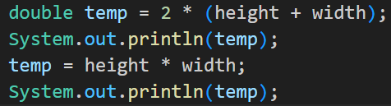
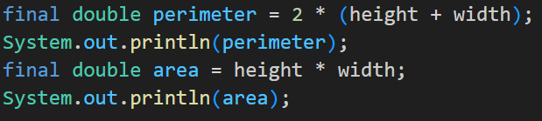
Split Temporary Variable
Problem: You have a local variable that’s used to store various intermediate values inside a method (except for cycle variables).
Solution: Use different variables for different values. Each variable should be responsible for only one particular thing.

Slide 21
Split Temporary Variable
Why Refactor?
If you’re skimping on the number of variables inside a function and reusing them for various unrelated purposes, you’re sure to encounter problems as soon as you need to make changes to the code containing the variables. You will have to recheck each case of variable use to make sure that the correct values are used.
Benefits
Each component of the program code should be responsible for one and one thing only. This makes it much easier to maintain the code, since you can easily replace any particular thing without fear of unintended effects.
Code becomes more readable. If a variable was created long ago in a rush, it probably has a name that doesn’t explain anything: k, a2, value, etc. But you can fix this situation by naming the new variables in an understandable, self-explanatory way. Such names might resemble customerTaxValue, cityUnemploymentRate, clientSalutationString and the like.
This refactoring technique is useful if you anticipate using Extract Method later.

Slide 22
Split Temporary Variable
How to Refactor?
Find the first place in the code where the variable is given a value. Here you should rename the variable with a name that corresponds to the value being assigned.
Use the new name instead of the old one in places where this value of the variable is used.
Repeat as needed for places where the variable is assigned a different value.

Slide 23
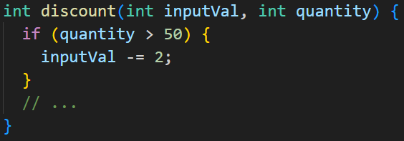
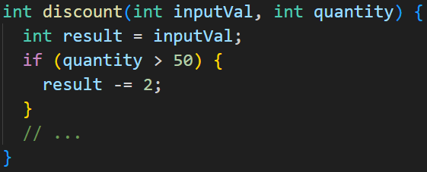
Remove Assignments to Parameters
Problem: Some value is assigned to a parameter inside method’s body.
Solution: Use a local variable instead of a parameter.

Slide 24
Remove Assignments to Parameters
Why Refactor?
The reasons for this refactoring are the same as for Split Temporary Variable, but in this case, we’re dealing with a parameter, not a local variable.
First, if a parameter is passed via reference, then after the parameter value is changed inside the method, this value is passed to the argument that requested calling this method. Very often, this occurs accidentally and leads to unfortunate effects. Even if parameters are usually passed by value (and not by reference) in your programming language, this coding quirk may alienate those who are unaccustomed to it.
Second, multiple assignments of different values to a single parameter make it difficult for you to know what data should be contained in the parameter at any particular point in time. The problem worsens if your parameter and its contents are documented but the actual value is capable of differing from what’s expected inside the method.

Slide 25
Remove Assignments to Parameters
Benefits
Each element of the program should be responsible for only one thing. This makes code maintenance much easier going forward, since you can safely replace code without any side effects.
This refactoring helps to extract repetitive code to separate methods.
How to Refactor?
Create a local variable and assign the initial value of your parameter.
In all method code that follows this line, replace the parameter with your new local variable.

Slide 26
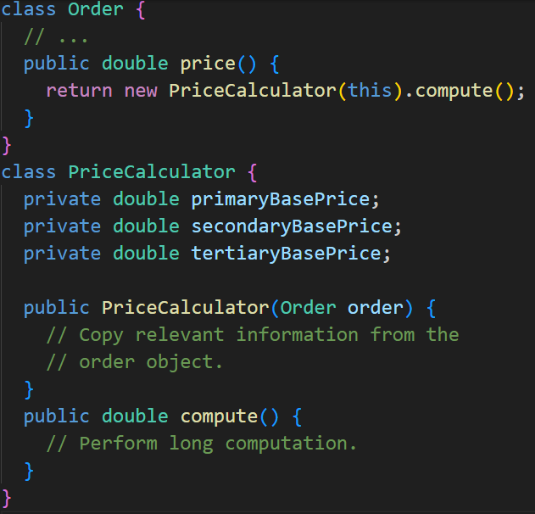
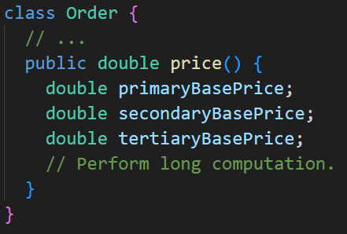
Replace Method with Method Object
Problem: You have a long method in which the local variables are so intertwined that you can’t apply Extract Method.
Solution: Transform the method into a separate class so that the local variables become fields of the class. Then you can split the method into several methods within the same class.

Slide 27
Replace Method with Method Object
Why Refactor?
A method is too long, and you can’t separate it due to tangled masses of local variables that are hard to isolate from each other.
The first step is to isolate the entire method into a separate class and turn its local variables into fields of the class.
Firstly, this allows isolating the problem at the class level. Secondly, it paves the way for splitting a large and unwieldy method into smaller ones that wouldn’t fit with the purpose of the original class anyway.

Slide 28
Replace Method with Method Object
Benefits
Isolating a long method in its own class allows stopping a method from ballooning in size. This also allows splitting it into submethods within the class, without polluting the original class with utility methods.
Drawbacks
Another class is added, increasing the overall complexity of the program.

Slide 29
Replace Method with Method Object
How to Refactor?
Create a new class. Name it based on the purpose of the method that you’re refactoring.
In the new class, create a private field for storing a reference to an instance of the class in which the method was previously located. It could be used to get some required data from the original class if needed.
Create a separate private field for each local variable of the method.
Create a constructor that accepts as parameters the values of all local variables of the method and also initializes the corresponding private fields.
Declare the main method and copy the code of the original method to it, replacing the local variables with private fields.
Replace the body of the original method in the original class by creating a method object and calling its main method.

Slide 30
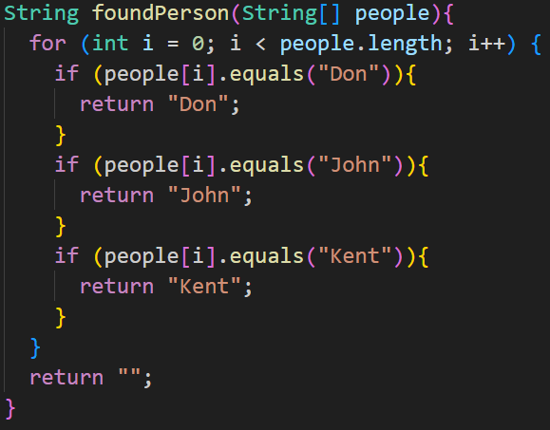
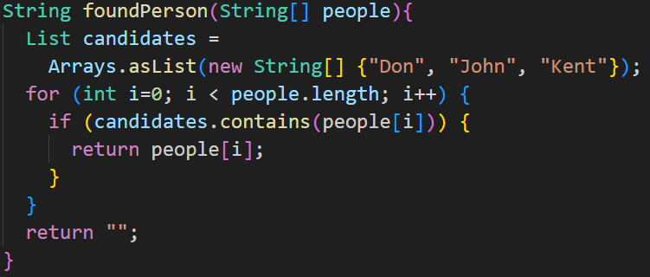
Substitute Algorithm
Problem: So you want to replace an existing algorithm with a new one?
Solution: Replace the body of the method that implements the algorithm with a new algorithm.

Slide 31
Substitute Algorithm
Why Refactor?
Gradual refactoring isn’t the only method for improving a program. Sometimes a method is so cluttered with issues that it’s easier to tear down the method and start fresh. And perhaps you have found an algorithm that’s much simpler and more efficient. If this is the case, you should simply replace the old algorithm with the new one.
As time goes on, your algorithm may be incorporated into a well-known library or framework and you want to get rid of your independent implementation, in order to simplify maintenance.
The requirements for your program may change so heavily that your existing algorithm can’t be salvaged for the task.

Slide 32
Substitute Algorithm
How to Refactor?
Make sure that you have simplified the existing algorithm as much as possible. Move unimportant code to other methods using Extract Method. The fewer moving parts in your algorithm, the easier it’s to replace.
Create your new algorithm in a new method. Replace the old algorithm with the new one and start testing the program.
If the results don’t match, return to the old implementation and compare the results. Identify the causes of the discrepancy. While the cause is often an error in the old algorithm, it’s more likely due to something not working in the new one.
When all tests are successfully completed, delete the old algorithm for good!

Slide 33
Moving Features between Objects
Even if you have distributed functionality among different classes in a less-than-perfect way, there’s still hope.
These refactoring techniques show how to safely move functionality between classes, create new classes, and hide implementation details from public access.
Techniques:
Move Method
Move Field
Extract Class
Inline Class
Hide Delegate
Remove Middle Man
Introduce Foreign Method
Introduce Local Extension

Slide 34
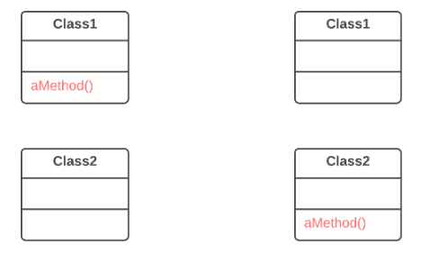
Move Method
Problem: A method is used more in another class than in its own class.
Solution: Create a new method in the class that uses the method the most, then move code from the old method to there. Turn the code of the original method into a reference to the new method in the other class or else remove it entirely.

Slide 35
Move Method
Why Refactor?
You want to move a method to a class that contains most of the data used by the method. This makes classes more internally coherent.
You want to move a method in order to reduce or eliminate the dependency of the class calling the method on the class in which it’s located. This can be useful if the calling class is already dependent on the class to which you’re planning to move the method. This reduces dependency between classes.

Slide 36
Move Method
How to Refactor?
Verify all features used by the old method in its class. It may be a good idea to move them as well. As a rule, if a feature is used only by the method under consideration, you should certainly move the feature to it. If the feature is used by other methods too, you should move these methods as well. Sometimes it’s much easier to move a large number of methods than to set up relationships between them in different classes.
Make sure that the method isn’t declared in superclasses and subclasses. If this is the case, you will either have to refrain from moving or else implement a kind of polymorphism in the recipient class in order to ensure varying functionality of a method split up among donor classes.
Declare the new method in the recipient class. You may want to give a new name for the method that’s more appropriate for it in the new class.

Slide 37
Move Method
How to Refactor?
Decide how you will refer to the recipient class. You may already have a field or method that returns an appropriate object, but if not, you will need to write a new method or field to store the object of the recipient class.
Now you have a way to refer to the recipient object and a new method in its class. With all this under your belt, you can turn the old method into a reference to the new method.
Take a look: can you delete the old method entirely? If so, place a reference to the new method in all places that use the old one..

Slide 38
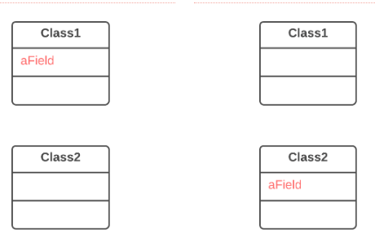

Move Field
Problem: A field is used more in another class than in its own class.
Solution: Create a field in a new class and redirect all users of the old field to it.

Slide 39
Move Field
Why Refactor?
Often fields are moved as part of the Extract Class technique. Deciding which class to leave the field in can be tough. Here is our rule of thumb: put a field in the same place as the methods that use it (or else where most of these methods are).
This rule will help in other cases when a field is simply located in the wrong place.

Slide 40
Move Field
How to Refactor?
If the field is public, refactoring will be much easier if you make the field private and provide public access methods (for this, you can use Encapsulate Field).
Create the same field with access methods in the recipient class.
Decide how you will refer to the recipient class. You may already have a field or method that returns the appropriate object; if not, you will need to write a new method or field to store the object of the recipient class.
Replace all references to the old field with appropriate calls to methods in the recipient class. If the field isn’t private, take care of this in the superclass and subclasses.
Delete the field in the original class.

Slide 41
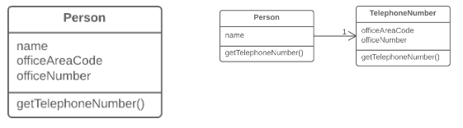
Extract Class
Problem: When one class does the work of two, awkwardness results.
Solution: Instead, create a new class and place the fields and methods responsible for the relevant functionality in it.

Slide 42
Extract Class
Why Refactor?
Classes always start out clear and easy to understand. They do their job and mind their own business as it were, without butting into the work of other classes. But as the program expands, a method is added and then a field... and eventually, some classes are performing more responsibilities than ever envisioned.
Benefits
This refactoring method will help maintain adherence to the Single Responsibility Principle. The code of your classes will be more obvious and understandable.
Single-responsibility classes are more reliable and tolerant of changes. For example, say that you have a class responsible for ten different things. When you change this class to make it.
Drawbacks
If you “overdo it” with this refactoring technique, you will have to resort to Inline Class.
better for one thing, you risk breaking it for the nine others.

Slide 43
Extract Class
How to Refactor?
Before starting, decide on how exactly you want to split up the responsibilities of the class.
Create a new class to contain the relevant functionality.
Create a relationship between the old class and the new one. Optimally, this relationship is unidirectional; this allows reusing the second class without any issues. Nonetheless, if you think that a two-way relationship is necessary, this can always be set up.
Use Move Field and Move Method for each field and method that you have decided to move to the new class. For methods, start with private ones in order to reduce the risk of making a large number of errors. Try to relocate just a little bit at a time and test the results after each move, in order to avoid a pileup of error-fixing at the very end.
After you’re done moving, take one more look at the resulting classes. An old class with changed responsibilities may be renamed for increased clarity. Check again to see whether you can get rid of two-way class relationships, if any are present.
Also give thought to accessibility to the new class from the outside. You can hide the class from the client entirely by making it private, managing it via the fields from the old class. Alternatively, you can make it a public one by allowing the client to change values directly. Your decision here depends on how safe it’s for the behavior of the old class when unexpected direct changes are made to the values in the new class.

Slide 44
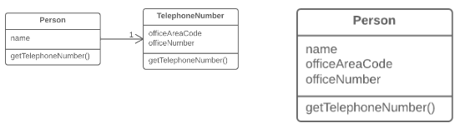
Inline Class
Problem: A class does almost nothing and isn’t responsible for anything, and no additional responsibilities are planned for it.
Solution: Move all features from the class to another one.

Slide 45
Inline Class
Why Refactor?
Often this technique is needed after the features of one class are “transplanted” to other classes, leaving that class with little to do.
Benefits
Eliminating needless classes frees up operating memory on the computer—and bandwidth in your head.

Slide 46
Inline Class
How to Refactor?
In the recipient class, create the public fields and methods present in the donor class. Methods should refer to the equivalent methods of the donor class.
Replace all references to the donor class with references to the fields and methods of the recipient class.
Now test the program and make sure that no errors have been added. If tests show that everything is working A-OK, start using Move Method and Move Field to completely transplant all functionality to the recipient class from the original one. Continue doing so until the original class is completely empty.
Delete the original class.

Slide 47
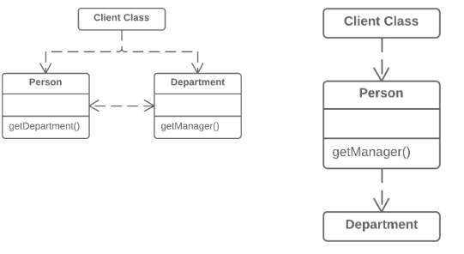
Hide Delegate
Problem: The client gets object B from a field or method of object А. Then the client calls a method of object B.
Solution: Create a new method in class A that delegates the call to object B. Now the client doesn’t know about, or depend on, class B.

Slide 48
Hide Delegate
Why Refactor?
To start with, let’s look at terminology:
Server is the object to which the client has direct access.
Delegate is the end object that contains the functionality needed by the client.
A call chain appears when a client requests an object from another object, then the second object requests another one, and so on. These sequences of calls involve the client in navigation along the class structure. Any changes in these interrelationships will require changes on the client side.
Benefits
Hides delegation from the client. The less that the client code needs to know about the details of relationships between objects, the easier it’s to make changes to your program.

Slide 49
Hide Delegate
Drawbacks
If you need to create an excessive number of delegating methods, server-class risks becoming an unneeded go-between, leading to an excess of Middle Man.
How to Refactor?
For each method of the delegate-class called by the client, create a method in the server-class that delegates the call to the delegate-class.
Change the client code so that it calls the methods of the server-class.
If your changes free the client from needing the delegate-class, you can remove the access method to the delegate-class from the server-class (the method that was originally used to get the delegate-class).

Slide 50
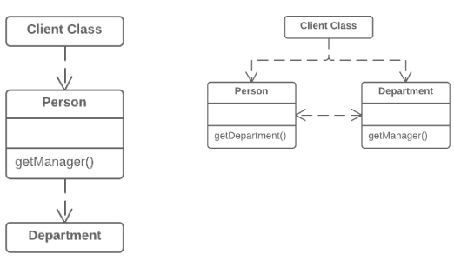
Remove Middle Man
Problem: A class has too many methods that simply delegate to other objects.
Solution: Delete these methods and force the client to call the end methods directly.

Slide 51
Remove Middle Man
Why Refactor?
To describe this technique, we’ll use the terms from Hide Delegate, which are:
Server is the object to which the client has direct access.
Delegate is the end object that contains the functionality needed by the client.
There are two types of problems:
The server-class doesn’t do anything itself and simply creates needless complexity. In this case, give thought to whether this class is needed at all.
Every time a new feature is added to the delegate, you need to create a delegating method for it in the server-class. If a lot of changes are made, this will be rather tiresome.

Slide 52
Remove Middle Man
How to Refactor?
Create a getter for accessing the delegate-class object from the server-class object.
Replace calls to delegating methods in the server-class with direct calls for methods in the delegate-class.

Slide 53
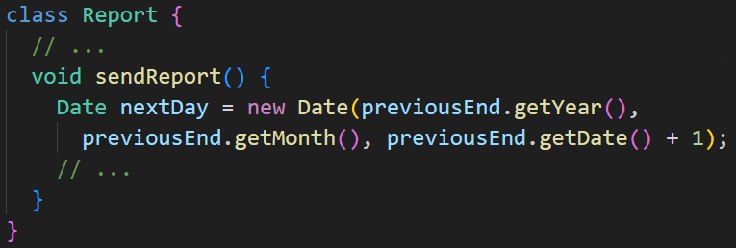
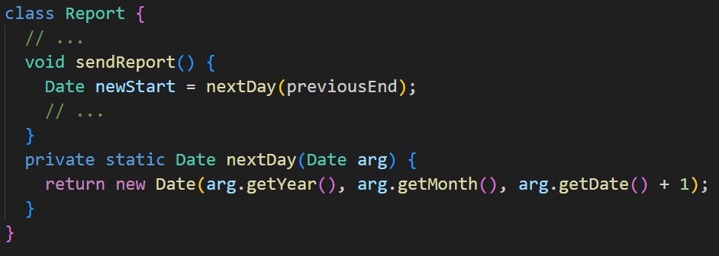
Introduce Foreign Method
Problem: A utility class doesn’t contain the method that you need and you can’t add the method to the class.
Solution: Add the method to a client class and pass an object of the utility class to it as an argument.

Slide 54
Introduce Foreign Method
Why Refactor?
You have code that uses the data and methods of a certain class. You realize that the code will look and work much better inside a new method in the class. But you can’t add the method to the class because, for example, the class is located in a third-party library.
This refactoring has a big payoff when the code that you want to move to the method is repeated several times in different places in your program.
Since you’re passing an object of the utility class to the parameters of the new method, you have access to all of its fields. Inside the method, you can do practically everything that you want, as if the method were part of the utility class.

Slide 55
Introduce Foreign Method
Benefits
Removes code duplication. If your code is repeated in several places, you can replace these code fragments with a method call. This is better than duplication even considering that the foreign method is located in a suboptimal place.
Drawbacks
The reasons for having the method of a utility class in a client class won’t always be clear to the person maintaining the code after you. If the method can be used in other classes, you could benefit by creating a wrapper for the utility class and placing the method there. This is also beneficial when there are several such utility methods. Introduce Local Extension can help with this.

Slide 56
Introduce Foreign Method
How to Refactor?
Create a new method in the client class.
In this method, create a parameter to which the object of the utility class will be passed. If this object can be obtained from the client class, you don’t have to create such a parameter.
Extract the relevant code fragments to this method and replace them with method calls.
Be sure to leave the Foreign method tag in the comments for the method along with the advice to place this method in a utility class if such becomes possible later. This will make it easier to understand why this method is located in this particular class for those who’ll be maintaining the software in the future.

Slide 57
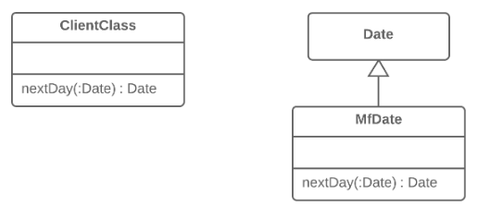
Introduce Local Extension
Problem: A utility class doesn’t contain some methods that you need. But you can’t add these methods to the class.
Solution: Create a new class containing the methods and make it either the child or wrapper of the utility class.

Slide 58
Introduce Local Extension
Why Refactor?
The class that you’re using doesn’t have the methods that you need. What’s worse, you can’t add these methods (because the classes are in a third-party library, for example). There are two ways out:
Create a subclass from the relevant class, containing the methods and inheriting everything else from the parent class. This way is easier but is sometimes blocked by the utility class itself (due to final).
Create a wrapper class that contains all the new methods and elsewhere will delegate to the related object from the utility class. This method is more work since you need not only code to maintain the relationship between the wrapper and utility object, but also a large number of simple delegating methods in order to emulate the public interface of the utility class.

Slide 59
Introduce Local Extension
Benefits
By moving additional methods to a separate extension class (wrapper or subclass), you avoid gumming up client classes with code that doesn’t fit. Program components are more coherent and are more reusable.

Slide 60
Introduce Local Extension
How to Refactor?
Create a new extension class:
Option A: Make it a child of the utility class.
Option B: If you have decided to make a wrapper, create a field in it for storing the utility class object to which delegation will be made. When using this option, you will need to also create methods that repeat the public methods of the utility class and contain simple delegation to the methods of the utility object.
Create a constructor that uses the parameters of the constructor of the utility class.
Also create an alternative “converting” constructor that takes only the object of the original class in its parameters. This will help to substitute the extension for the objects of the original class.
Create new extended methods in the class. Move foreign methods from other classes to this class or else delete the foreign methods if their functionality is already present in the extension.
Replace use of the utility class with the new extension class in places where its functionality is needed.

Slide 61
Organizing Data
These refactoring techniques help with data handling, replacing primitives with rich class functionality.
Another important result is untangling of class associations, which makes classes more portable and reusable.
Techniques:
Self Encapsulate Field
Replace Data Value with Object
Change Value to Reference
Change Reference to Value
Replace Array with Object
Duplicate Observed Data
Change Unidirectional Association to Bidirectional
Change Bidirectional Association to Unidirectional
Replace Magic Number with Symbolic Constant
Encapsulate Field
Encapsulate Collection
Replace Type Code with Class
Replace Type Code with Subclasses
Replace Type Code with State/Strategy
Replace Subclass with Fields

Slide 62
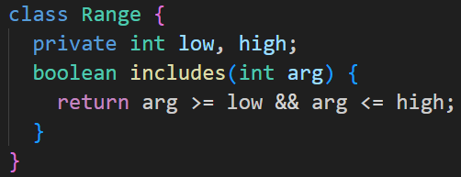
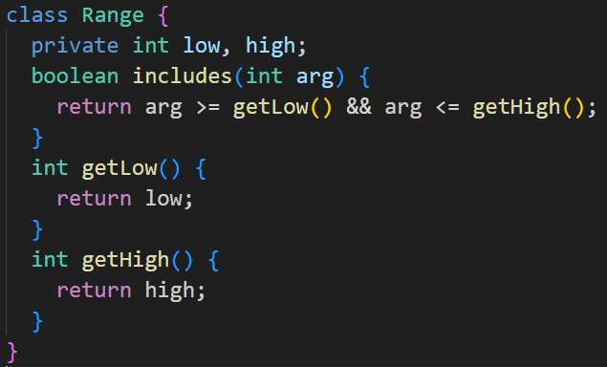
Self Encapsulate Field
Self-encapsulation is distinct from ordinary Encapsulate Field: the refactoring technique given here is performed on a private field.
Problem: You use direct access to private fields inside a class
Solution: Create a getter and setter for the field and use only them for accessing the field.

Slide 63
Self Encapsulate Field
Why Refactor?
Sometimes directly accessing a private field inside a class just isn’t flexible enough. You want to be able to initiate a field value when the first query is made or perform certain operations on new values of the field when they’re assigned or maybe do all this in various ways in subclasses.

Slide 64
Self Encapsulate Field
Benefits
Indirect access to fields is when a field is acted on via access methods (getters and setters). This approach is much more flexible than direct access to fields.
First, you can perform complex operations when data in the field is set or received. Lazy initialization and validation of field values are easily implemented inside field getters and setters.
Second and more crucially, you can redefine getters and setters in subclasses.
You have the option of not implementing a setter for a field at all. The field value will be specified only in the constructor, thus making the field unchangeable throughout the entire object lifespan.

Slide 65
Self Encapsulate Field
Drawbacks
When direct access to fields is used, code looks simpler and more presentable, although flexibility is diminished.
How to Refactor?
Create a getter (and optional setter) for the field. They should be either protected or public.
Find all direct invocations of the field and replace them with getter and setter calls.

Slide 66
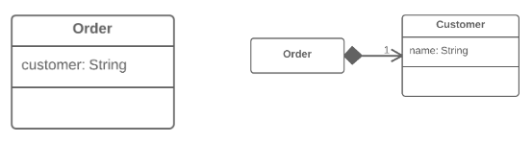
Replace Data Value with Object
Problem: A class (or group of classes) contains a data field. The field has its own behavior and associated data.
Solution: Create a new class, place the old field and its behavior in the class, and store the object of the class in the original class.

Slide 67
Replace Data Value with Object
Why Refactor?
This refactoring is basically a special case of Extract Class. What makes it different is the cause of the refactoring.
In Extract Class, we have a single class that’s responsible for different things and we want to split up its responsibilities.
With replacement of a data value with an object, we have a primitive field (number, string, etc.) that’s no longer so simple due to growth of the program and now has associated data and behaviors. On the one hand, there’s nothing scary about these fields in and of themselves. However, this fields-and-behaviors family can be present in several classes simultaneously, creating duplicate code.
Therefore, for all this we create a new class and move both the field and the related data and behaviors to it.

Slide 68
Replace Data Value with Object
Benefits
Improves relatedness inside classes. Data and the relevant behaviors are inside a single class.
How to Refactor?
Before you begin with refactoring, see if there are direct references to the field from within the class. If so, use Self Encapsulate Field to hide it in the original class.
Create a new class and copy your field and relevant getter to it. In addition, create a constructor that accepts the simple value of the field. This class won’t have a setter since each new field value that’s sent to the original class will create a new value object.
In the original class, change the field type to the new class.
In the getter in the original class, invoke the getter of the associated object.
In the setter, create a new value object. You may need to also create a new object in the constructor if initial values had been set there for the field previously.

Slide 69
Replace Data Value with Object
Next Steps
After applying this refactoring technique, it’s wise to apply Change Value to Reference on the field that contains the object. This allows storing a reference to a single object that corresponds to a value instead of storing dozens of objects for one and the same value.
Most often this approach is needed when you want to have one object be responsible for one real-world object (such as users, orders, documents and so forth). At the same time, this approach won’t be useful for objects such as dates, money, ranges, etc.

Slide 70

Change Value to Reference
Problem: So, you have many identical instances of a single class that you need to replace with a single object.
Solution: Convert the identical objects to a single reference object.

Slide 71
Change Value to Reference
In many systems, objects can be classified as either values or references.
References: when one real-world object corresponds to only one object in the program. References are usually user/order/product/etc. objects.
Values: one real-world object corresponds to multiple objects in the program. These objects could be dates, phone numbers, addresses, colors, and the like.
The selection of reference vs. value isn’t always clear-cut. Sometimes there’s a simple value with a small amount of unchanging data. Then it becomes necessary to add changeable data and pass these changes every time the object is accessed. In this case it becomes necessary to convert it to a reference.

Slide 72
Change Value to Reference
Benefits
An object contains all the most current information about a particular entity. If the object is changed in one part of the program, these changes are accessible from the other parts of the program that make use of the object.
Drawbacks
References are much harder to implement.

Slide 73
Change Value to Reference
How to Refactor?
Use Replace Constructor with Factory Method on the class from which the references are to be generated.
Determine which object will be responsible for providing access to references. Instead of creating a new object, when you need one, you now need to get it from a storage object or static dictionary field.
Determine whether references will be created in advance or dynamically as necessary. If objects are created in advance, make sure to load them before use.
Change the factory method so that it returns a reference. If objects are created in advance, decide how to handle errors when a non-existent object is requested. You may also need to use Rename Method to inform that the method returns only existing objects.

Slide 74
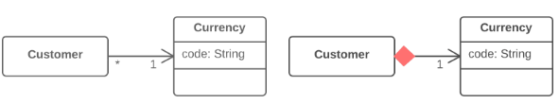
Change Reference to Value
Problem: You have a reference object that’s too small and infrequently changed to justify managing its life cycle.
Solution: Turn it into a value object.

Slide 75
Change Reference to Value
Why Refactor?
Inspiration to switch from a reference to a value may come from the inconvenience of working with the reference. References require management on your part:
They always require requesting the necessary object from storage.
References in memory may be inconvenient to work with.
Working with references is particularly difficult, compared to values, on distributed and parallel systems.
Values are especially useful if you would rather have unchangeable objects than objects whose state may change during their lifetime.

Slide 76
Change Reference to Value
Benefits
One important property of objects is that they should be unchangeable. The same result should be received for each query that returns an object value. If this is true, no problems arise if there are many objects representing the same thing.
Values are much easier to implement.
Drawbacks
If a value is changeable, make sure if any object changes that the values in all the other objects representing the same entity are updated. This is so burdensome that it’s easier to create a reference for this purpose.

Slide 77
Change Reference to Value
How to Refactor?
Make the object unchangeable. The object shouldn’t have any setters or other methods that change its state and data (Remove Setting Method may help here). The only place where data should be assigned to the fields of a value object is a constructor.
Create a comparison method to be able to compare two values.
Check whether you can delete the factory method and make the object constructor public.

Slide 78
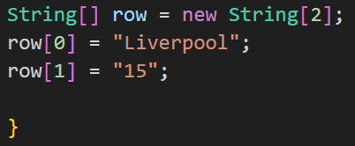
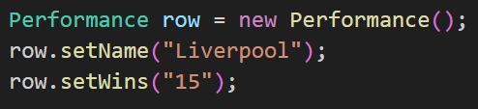
Replace Array with Object
This refactoring technique is a special case of Replace Data Value with Object.
Problem: You have an array that contains various types of data.
Solution: Replace the array with an object that will have separate fields for each element.

Slide 79
Replace Array with Object
Why Refactor?
Arrays are an excellent tool for storing data and collections of a single type. But if you use an array like post office boxes, storing the username in box 1 and the user’s address in box 14, you will someday be very unhappy that you did. This approach leads to catastrophic failures when somebody puts something in the wrong “box” and requires your time for figuring out which data is stored where.
Benefits
In the resulting class, you can place all associated behaviors that had been previously stored in the main class or elsewhere.
The fields of a class are much easier to document than the elements of an array.

Slide 80
Replace Array with Object
How to Refactor?
Create the new class that will contain the data from the array. Place the array itself in the class as a public field.
Create a field for storing the object of this class in the original class. Don’t forget to also create the object itself in the place where you initiated the data array.
In the new class, create access methods one by one for each of the array elements. Give them self-explanatory names that indicate what they do. At the same time, replace each use of an array element in the main code with the corresponding access method.
When access methods have been created for all elements, make the array private.
For each element of the array, create a private field in the class and then change the access methods so that they use this field instead of the array.
When all data has been moved, delete the array.

Slide 81
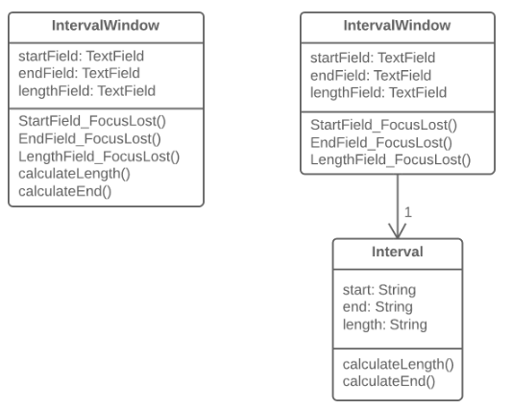
Duplicate Observed Data
Problem: Is domain data stored in classes responsible for the GUI?
Solution: Then it’s a good idea to separate the data into separate classes, ensuring connection and synchronization between the domain class and the GUI.

Slide 82
Duplicate Observed Data
Why Refactor?
You want to have multiple interface views for the same data (for example, you have both a desktop app and a mobile app). If you fail to separate the GUI from the domain, you will have a very hard time avoiding code duplication and many mistakes.
Benefits
You split responsibility between business logic classes and presentation classes (cf. the Single Responsibility Principle), which makes your program more readable and understandable.
If you need to add a new interface view, create new presentation classes; you don’t need to touch the code of the business logic (cf. the Open/Closed Principle).
Now different people can work on the business logic and the user interfaces.

Slide 83
Duplicate Observed Data
When Not to Use
This refactoring technique, which in its classic form is performed using the Observer template, isn’t applicable for web apps, where all classes are recreated between queries to the web server.
All the same, the general principle of extracting business logic into separate classes can be justified for web apps as well. But this will be implemented using different refactoring techniques depending on how your system is designed.

Slide 84
Duplicate Observed Data
How to Refactor?
Hide direct access to domain data in the GUI class. For this, it’s best to use Self Encapsulate Field. So, you create the getters and setters for this data.
In handlers for GUI class events, use setters to set new field values. This will let you pass these values to the associated domain object.
Create a domain class and copy necessary fields from the GUI class to it. Create getters and seters for all these fields.

Slide 85
Duplicate Observed Data
How to Refactor?
Create an Observer pattern for these two classes:
In the domain class, create an array for storing observer objects (GUI objects), as well as methods for registering, deleting and notifying them.
In the GUI class, create a field for storing references to the domain class as well as the update() method, which will be reacting to changes in the object and update the values of fields in the GUI class. Note that value updates should be established directly in the method, in order to avoid recursion.
In the GUI class constructor, create an instance of domain class and save it in the field you have created. Register the GUI object as an observer in the domain object.
In the setters for domain class fields, call the method for notifying the observer (in other words, method for updating in the GUI class), in order to pass the new values to the GUI.
Change the setters of the GUI class fields so that they set new values in the domain object directly. Watch out to make sure that values aren’t set through a domain class setter—otherwise infinite recursion will result.

Slide 86

Change Unidirectional Association to Bidirectional
Problem: You have two classes that each need to use the features of the other, but the association between them is only unidirectional.
Solution: Add the missing association to the class that needs it.

Slide 87
Change Unidirectional Association to Bidirectional
Why Refactor?
Originally the classes had a unidirectional association. But with time, client code needed access to both sides of the association.
Benefits
If a class needs a reverse association, you can simply calculate it. But if these calculations are complex, it’s better to keep the reverse association.
Drawbacks
Bidirectional associations are much harder to implement and maintain than unidirectional ones.
Bidirectional associations make classes interdependent. With a unidirectional association, one of them can be used independently of the other.

Slide 88
Change Unidirectional Association to Bidirectional
How to Refactor?
Add a field for holding the reverse association.
Decide which class will be “dominant”. This class will contain the methods that create or update the association as elements are added or changed, establishing the association in its class and calling the utility methods for establishing the association in the associated object.
Create a utility method for establishing the association in the “non-dominant” class. The method should use what it’s given in parameters to complete the field. Give the method an obvious name so that it isn’t used later for any other purposes.
If old methods for controlling the unidirectional association were in the “dominant” class, complement them with calls to utility methods from the associated object.
If the old methods for controlling the association were in the “non-dominant” class, create the methods in the “dominant” class, call them, and delegate execution to them.

Slide 89

Change Bidirectional Association to Unidirectional
Problem: You have a bidirectional association between classes, but one of the classes doesn’t use the other’s features.
Solution: Remove the unused association

Slide 90
Change Bidirectional Association to Unidirectional
Why Refactor?
A bidirectional association is generally harder to maintain than a unidirectional one, requiring additional code for properly creating and deleting the relevant objects. This makes the program more complicated.
In addition, an improperly implemented bidirectional association can cause problems for garbage collection (in turn leading to memory bloat by unused objects).
Example: the garbage collector removes objects from memory that are no longer referenced by other objects. Let’s say that an object pair User-Order was created, used, and then abandoned. But these objects won’t be cleared from memory since they still refer to each other. That said, this problem is becoming less important thanks to advances in programming languages, which now automatically identify unused object references and remove them from memory.
There’s also the problem of interdependency between classes. In a bidirectional association, the two classes must know about each other, meaning that they can’t be used separately. If many of these associations are present, different parts of the program become too dependent on each other and any changes in one component may affect the other components.

Slide 91
Change Bidirectional Association to Unidirectional
Benefits
Simplifies the class that doesn’t need the relationship. Less code equals less code maintenance.
Reduces dependency between classes. Independent classes are easier to maintain since any changes to a class affect only that class.

Slide 92
Change Bidirectional Association to Unidirectional
How to Refactor?
Make sure that one of the following is true for your classes:
No association is used.
There’s another way to get the associated object, such through a database query.
The associated object can be passed as an argument to the methods that use it.
Depending on your situation, use of a field that contains an association with another object should be replaced by a parameter or method call for getting the object in a different way.
Delete the code that assigns the associated object to the field.
Delete the now-unused field.

Slide 93
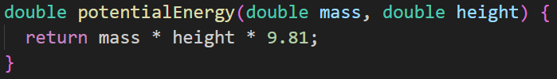
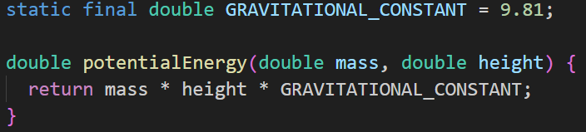
Replace Magic Number with Symbolic Constant
Problem: Your code uses a number that has a certain meaning to it.
Solution: Replace this number with a constant that has a human-readable name explaining the meaning of the number.

Slide 94
Replace Magic Number with Symbolic Constant
Why Refactor?
A magic number is a numeric value that’s encountered in the source but has no obvious meaning. This “anti-pattern” makes it harder to understand the program and refactor the code.
Yet more difficulties arise when you need to change this magic number. Find and replace won’t work for this: the same number may be used for different purposes in different places, meaning that you will have to verify every line of code that uses this number.

Slide 95
Replace Magic Number with Symbolic Constant
Benefits
The symbolic constant can serve as live documentation of the meaning of its value.
It’s much easier to change the value of a constant than to search for this number throughout the entire codebase, without the risk of accidentally changing the same number used elsewhere for a different purpose.
Reduce duplicate use of a number or string in the code. This is especially important when the value is complicated and long (such as 3.14159 or 0xCAFEBABE).

Slide 96
Replace Magic Number with Symbolic Constant
Good to Know
Not all numbers are magical.
If the purpose of a number is obvious, there’s no need to replace it. A classic example is:
for (i = 0; i < сount; i++) { ... }

Slide 97
Replace Magic Number with Symbolic Constant
Alternatives
Sometimes a magic number can be replaced with method calls. For example, if you have a magic number that signifies the number of elements in a collection, you don’t need to use it for checking the last element of the collection. Instead, use the standard method for getting the collection length.
Magic numbers are sometimes used as type code. Say that you have two types of users and you use a number field in a class to specify which is which: administrators are 1 and ordinary users are 2.
In this case, you should use one of the refactoring methods to avoid type code:
Replace Type Code with Class
Replace Type Code with Subclasses
Replace Type Code with State/Strategy

Slide 98
Replace Magic Number with Symbolic Constant
How to Refactor?
Declare a constant and assign the value of the magic number to it.
Find all mentions of the magic number.
For each of the numbers that you find, double-check that the magic number in this particular case corresponds to the purpose of the constant. If yes, replace the number with your constant. This is an important step, since the same number can mean absolutely different things (and replaced with different constants, as the case may be).

Slide 99

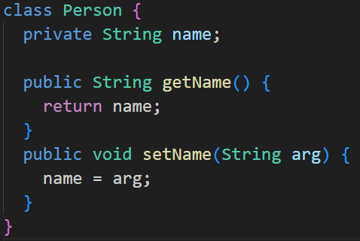
Encapsulate Field
Problem: You have a public field.
Solution: Make the field private and create access methods for it.

Slide 100
Encapsulate Field
Why Refactor?
One of the pillars of object-oriented programming is Encapsulation, the ability to conceal object data. Otherwise, all objects would be public and other objects could get and modify the data of your object without any checks and balances! Data is separated from the behaviors associated with this data, modularity of program sections is compromised, and maintenance becomes complicated.
Benefits
If the data and behavior of a component are closely interrelated and are in the same place in the code, it’s much easier for you to maintain and develop this component.
You can also perform complicated operations related to access to object fields.

Slide 101
Encapsulate Field
When Not to Use?
In some cases, encapsulation is ill-advised due to performance considerations. These cases are rare but when they happen, this circumstance is very important.
Say that you have a graphical editor that contains objects possessing x- and y-coordinates. These fields are unlikely to change in the future. What’s more, the program involves a great many different objects in which these fields are present. So, accessing the coordinate fields directly saves significant CPU cycles that would otherwise be taken up by calling access methods.
As an example of this unusual case, there’s the Point class in Java. All fields of this class are public.

Slide 102
Encapsulate Field
How to Refactor?
Create a getter and setter for the field.
Find all invocations of the field. Replace receipt of the field value with the getter and replace setting of new field values with the setter.
After all field invocations have been replaced, make the field private.
Next Steps
Encapsulate Field is only the first step in bringing data and the behaviors involving this data closer together. After you create simple methods for access fields, you should recheck the places where these methods are called. It’s quite possible that the code in these areas would look more appropriate in the access methods.

Slide 103
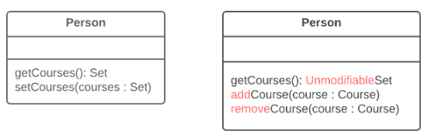
Encapsulate Collection
Problem: A class contains a collection field and a simple getter and setter for working with the collection.
Solution: Make the getter-returned value read-only and create methods for adding/deleting elements of the collection.

Slide 104
Encapsulate Collection
Why Refactor?
A class contains a field that contains a collection of objects. This collection could be an array, list, set or vector. A normal getter and setter have been created for working with the collection.
But the collections should be used by a protocol that’s a bit different from the one used by other data types. The getter method shouldn’t return the collection object itself, since this would let clients change collection contents without the knowledge of the owner class. In addition, this would show too much of the internal structures of the object data to clients. The method for getting collection elements should return a value that doesn’t allow changing the collection or disclose excessive data about its structure.
In addition, there shouldn’t be a method that assigns a value to the collection. Instead, there should be operations for adding and deleting elements. Thanks to this, the owner object gains control over addition and deletion of collection elements.
Such a protocol properly encapsulates a collection, which ultimately reduces the degree of association between the owner class and the client code.

Slide 105
Encapsulate Collection
Benefits
The collection field is encapsulated inside a class. When the getter is called, it returns a copy of the collection, which prevents accidental changing or overwriting of the collection elements without the knowledge of the class that contains the collection.
If collection elements are contained inside a primitive type, such as an array, you create more convenient methods for working with the collection.
If collection elements are contained inside a non-primitive container (standard collection class), by encapsulating the collection you can restrict access to unwanted standard methods of the collection (such as by restricting addition of new elements).

Slide 106
Encapsulate Collection
How to Refactor?
Create methods for adding and deleting collection elements. They must accept collection elements in their parameters.
Assign an empty collection to the field as the initial value if this isn’t done in the class constructor.
Find the calls of the collection field setter. Change the setter so that it uses operations for adding and deleting elements or make these operations call client code.
Note that setters can be used only to replace all collection elements with other ones. Therefore, it may be advisable to change the setter name (Rename Method) to replace.
Find all calls of the collection getter after which the collection is changed. Change the code so that it uses your new methods for adding and deleting elements from the collection.
Change the getter so that it returns a read-only representation of the collection.
Inspect the client code that uses the collection for code that would look better inside of the collection class itself.

Slide 107

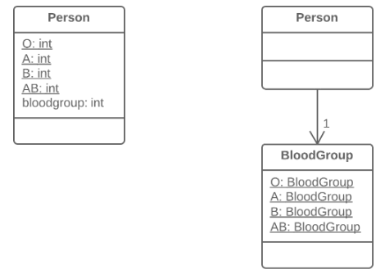
Replace Type Code with Class
Problem: A class has a field that contains type code. The values of this type aren’t used in operator conditions and don’t affect the behavior of the program.
Solution: Create a new class and use its objects instead of the type code values.

Slide 108
Replace Type Code with Class
Why Refactor?
One of the most common reasons for type code is working with databases, when a database has fields in which some complex concept is coded with a number or string.
For example, you have the class User with the field user_role, which contains information about the access privileges of each user, whether administrator, editor, or ordinary user. So, in this case, this information is coded in the field as A, E, and U respectively.
What are the shortcomings of this approach? The field setters often don’t check which value is sent, which can cause big problems when someone sends unintended or wrong values to these fields.
In addition, type verification is impossible for these fields. It’s possible to send any number or string to them, which won’t be type checked by your IDE and even allow your program to run (and crash later).

Slide 109
Replace Type Code with Class
Benefits
We want to turn sets of primitive values—which is what coded types are—into full-fledged classes with all the benefits that object-oriented programming has to offer.
By replacing type code with classes, we allow type hinting for values passed to methods and fields at the level of the programming language.
For example, while the compiler previously didn’t see difference between your numeric constant and some arbitrary number when a value is passed to a method, now when data that doesn’t fit the indicated type class is passed, you’re warned of the error inside your IDE.
Thus, we make it possible to move code to the classes of the type. If you needed to perform complex manipulations with type values throughout the whole program, now this code can “live” inside one or multiple type classes.

Slide 110
Replace Type Code with Class
When Not to Use
If the values of a coded type are used inside control flow structures (if, switch, etc.) and control a class behavior, you should use one of the two refactoring techniques for type code:
Replace Type Code with Subclasses
Replace Type Code with State/Strategy

Slide 111
Replace Type Code with Class
How to Refactor?
Create a new class and give it a new name that corresponds to the purpose of the coded type. Here we’ll call it type class.
Copy the field containing type code to the type class and make it private. Then create a getter for the field. A value will be set for this field only from the constructor.
For each value of the coded type, create a static method in type class. It’ll be creating a new type class object corresponding to this value of the coded type.
In the original class, replace the type of the coded field with type class. Create a new object of this type in the constructor as well as in the field setter. Change the field getter so that it calls the type class getter.
Replace any mentions of values of the coded type with calls of the relevant type class static methods.
Remove the coded type constants from the original class.

Slide 112
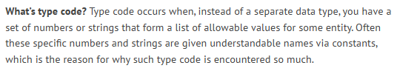
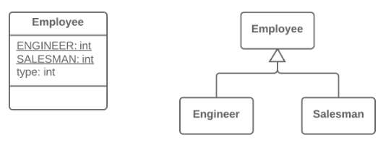
Replace Type Code with Subclasses
Problem: You have a coded type that directly affects program behavior (values of this field trigger various code in conditionals).
Solution: Create subclasses for each value of the coded type. Then extract the relevant behaviors from the original class to these subclasses. Replace the control flow code with polymorphism.

Slide 113
Replace Type Code with Subclasses
Why Refactor?
This refactoring technique is a more complicated twist on Replace Type Code with Class.
As in the first refactoring method, you have a set of simple values that constitute all the allowed values for a field. Although these values are often specified as constants and have understandable names, their use makes your code very error-prone since they’re still primitives in effect. For example, you have a method that accepts one of these values in the parameters. At a certain moment, instead of the constant USER_TYPE_ADMIN with the value "ADMIN", the method receives the same string in lower case ("admin"), which will cause execution of something else that the author (you) didn’t intend.
Here we’re dealing with control flow code such as the conditionals if, switch and ?:. In other words, fields with coded values (such as $user->type === self::USER_TYPE_ADMIN) are used inside the conditions of these operators. If we were to use Replace Type Code with Class here, all these control flow constructions would be best moved to a class responsible for the data type. Ultimately, this would of course create a type class very similar to the original one, with the same problems as well.

Slide 114
Replace Type Code with Subclasses
Benefits
Delete the control flow code. Instead of a bulky switch in the original class, move the code to appropriate subclasses. This improves adherence to the Single Responsibility Principle and makes the program more readable in general.
If you need to add a new value for a coded type, all you need to do is add a new subclass without touching the existing code (cf. the Open/Closed Principle).
By replacing type code with classes, we pave the way for type hinting for methods and fields at the level of the programming language. This wouldn’t be possible using simple numeric or string values contained in a coded type.

Slide 115
Replace Type Code with Subclasses
When Not to Use
This technique isn’t applicable if you already have a class hierarchy. You can’t create a dual hierarchy via inheritance in object-oriented programming. Still, you can replace type code via composition instead of inheritance. To do so, use Replace Type Code with State/Strategy.
If the values of type code can change after an object is created, avoid this technique. We would have to somehow replace the class of the object itself on the fly, which isn’t possible. Still, an alternative in this case too would be Replace Type Code with State/Strategy.

Slide 116
Replace Type Code with Subclasses
How to Refactor?
Use Self Encapsulate Field to create a getter for the field that contains type code.
Make the superclass constructor private. Create a static factory method with the same parameters as the superclass constructor. It must contain the parameter that will take the starting values of the coded type. Depending on this parameter, the factory method will create objects of various subclasses. To do so, in its code you must create a large conditional but, at least, it’ll be the only one when it’s truly necessary; otherwise, subclasses and polymorphism will do.
Create a unique subclass for each value of the coded type. In it, redefine the getter of the coded type so that it returns the corresponding value of the coded type.
Delete the field with type code from the superclass. Make its getter abstract.
Now that you have subclasses, you can start to move the fields and methods from the superclass to corresponding subclasses (with the help of Push Down Field and Push Down Method).
When everything possible has been moved, use Replace Conditional with Polymorphism in order to get rid of conditions that use the type code once and for all.

Slide 117

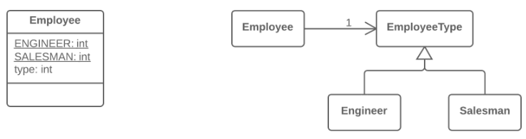
Replace Type Code with State/Strategy
Problem: You have a coded type that affects behavior, but you can’t use subclasses to get rid of it.
Solution: Replace type code with a state object. If it’s necessary to replace a field value with type code, another state object is “plugged in”.

Slide 118
Replace Type Code with State/Strategy
Why Refactor?
You have type code and it affects the behavior of a class, therefore we can’t use Replace Type Code with Class.
Type code affects the behavior of a class but we can’t create subclasses for the coded type due to the existing class hierarchy or other reasons. Thus. means that we can’t apply Replace Type Code with Subclasses.
Benefits
This refactoring technique is a way out of situations when a field with a coded type changes its value during the object’s lifetime. In this case, replacement of the value is made via replacement of the state object to which the original class refers.
If you need to add a new value of a coded type, all you need to do is to add a new state subclass without altering the existing code (cf. the Open/Closed Principle).

Slide 119
Replace Type Code with State/Strategy
Drawbacks
If you have a simple case of type code but you use this refactoring technique anyway, you will have many extra (and unneeded) classes.
Good to Know
Implementation of this refactoring technique can make use of one of two design patterns: State or Strategy. Implementation is the same no matter which pattern you choose. So which pattern should you pick in a particular situation?
If you’re trying to split a conditional that controls the selection of algorithms, use Strategy.
But if each value of the coded type is responsible not only for selecting an algorithm but for the whole condition of the class, class state, field values, and many other actions, State is better for the job.

Slide 120
Replace Type Code with State/Strategy
How to Refactor?
Use Self Encapsulate Field to create a getter for the field that contains type code.
Create a new class and give it an understandable name that fits the purpose of the type code. This class will be playing the role of state (or strategy). In it, create an abstract coded field getter.
Create subclasses of the state class for each value of the coded type. In each subclass, redefine the getter of the coded field so that it returns the corresponding value of the coded type.
In the abstract state class, create a static factory method that accepts the value of the coded type as a parameter. Depending on this parameter, the factory method will create objects of various states. For this, in its code create a large conditional; it’ll be the only one when refactoring is complete.
In the original class, change the type of the coded field to the state class. In the field’s setter, call the factory state method for getting new state objects.
Now you can start to move the fields and methods from the superclass to the corresponding state subclasses (using Push Down Field and Push Down Method).
When everything moveable has been moved, use Replace Conditional with Polymorphism to get rid of conditionals that use type code once and for all.

Slide 121
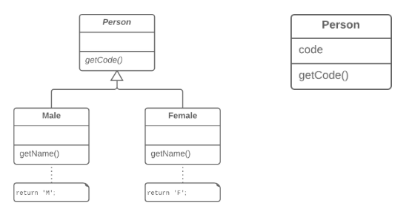
Replace Subclass with Fields
Problem: You have subclasses differing only in their (constant-returning) methods.
Solution: Replace the methods with fields in the parent class and delete the subclasses.

Slide 122
Replace Subclass with Fields
Why Refactor?
Sometimes refactoring is just the ticket for avoiding type code.
In one such case, a hierarchy of subclasses may be different only in the values returned by methods. These methods aren’t even the result of computation but are strictly set out in the methods themselves or in the fields returned by the methods. To simplify the class architecture, this hierarchy can be compressed into a single class containing one or several fields with the necessary values, based on the situation.
These changes may become necessary after moving a large amount of functionality from a class hierarchy to another place. The current hierarchy is no longer so valuable, and its subclasses are now just dead weight.
Benefits
Simplifies system architecture. Creating subclasses is overkill if all you want to do is to return different values in different methods.

Slide 123
Replace Subclass with Fields
How to Refactor?
Apply Replace Constructor with Factory Method to the subclasses.
Replace subclass constructor calls with superclass factory method calls.
In the superclass, declare fields for storing the values of each of the subclass methods that return constant values.
Create a protected superclass constructor for initializing the new fields.
Create or modify the existing subclass constructors so that they call the new constructor of the parent class and pass the relevant values to it.
Implement each constant method in the parent class so that it returns the value of the corresponding field. Then remove the method from the subclass.
If the subclass constructor has additional functionality, use Inline Method to incorporate the constructor into the superclass factory method.
Delete the subclass.

Slide 124
Simplifying Conditional Expressions
Conditionals tend to get more and more complicated in their logic over time, and there are yet more techniques to combat this as well.
Techniques:
Decompose Conditional
Consolidate Conditional Expression
Consolidate Duplicate Conditional Fragments
Remove Control Flag
Replace Nested Conditional with Guard Clauses
Replace Conditional with Polymorphism
Introduce Null Object
Introduce Assertion

Slide 125
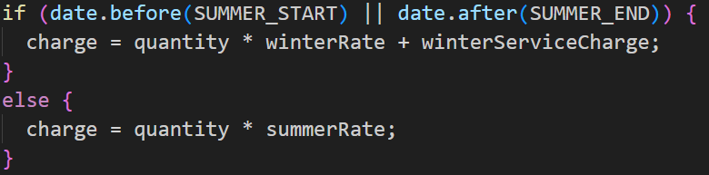
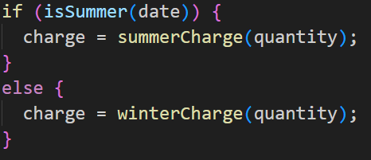
Decompose Conditional
Problem: You have a complex conditional (if-then/else or switch).
Solution: Decompose the complicated parts of the conditional into separate methods: the condition, then and else.

Slide 126
Decompose Conditional
Why Refactor?
The longer a piece of code is, the harder it’s to understand. Things become even more hard to understand when the code is filled with conditions:
While you’re busy figuring out what the code in the then block does, you forget what the relevant condition was.
While you’re busy parsing else, you forget what the code in then does.
Benefits
By extracting conditional code to clearly named methods, you make life easier for the person who’ll be maintaining the code later (such as you, two months from now!).
This refactoring technique is also applicable for short expressions in conditions. The string isSalaryDay() is much prettier and more descriptive than code for comparing dates.

Slide 127
Decompose Conditional
How to Refactor?
Extract the conditional to a separate method via Extract Method.
Repeat the process for the then and else blocks.

Slide 128
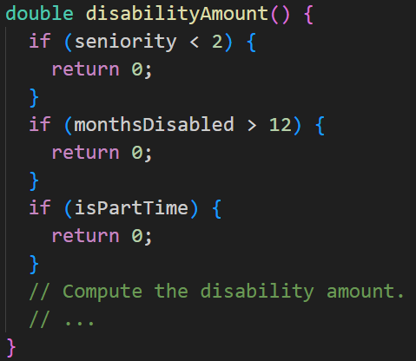
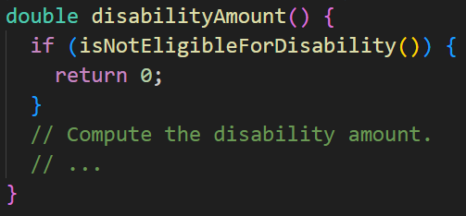
Consolidate Conditional Expression
Problem: You have multiple conditionals that lead to the same result or action.
Solution: Consolidate all these conditionals in a single expression.

Slide 129
Consolidate Conditional Expression
Why Refactor?
Your code contains many alternating operators that perform identical actions. It isn’t clear why the operators are split up.
The main purpose of consolidation is to extract the conditional to a separate method for greater clarity.
Benefits
Eliminates duplicate control flow code. Combining multiple conditionals that have the same “destination” helps to show that you’re doing only one complicated check leading to one action.
By consolidating all operators, you can now isolate this complex expression in a new method with a name that explains the conditional’s purpose.

Slide 130
Consolidate Conditional Expression
How to Refactor?
Before refactoring, make sure that the conditionals don’t have any “side effects” or otherwise modify something, instead of simply returning values. Side effects may be hiding in the code executed inside the operator itself, such as when something is added to a variable based on the results of a conditional.
Consolidate the conditionals in a single expression by using and and or. As a general rule when consolidating:
Nested conditionals are joined using and.
Consecutive conditionals are joined with or.
Perform Extract Method on the operator conditions and give the method a name that reflects the expression’s purpose.

Slide 131
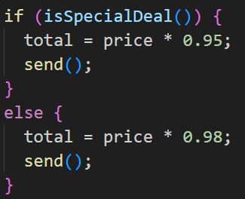
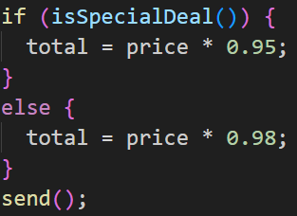
Consolidate Duplicate Conditional Fragments
Problem: Identical code can be found in all branches of a conditional.
Solution: Move the code outside of the conditional.

Slide 132
Consolidate Duplicate Conditional Fragments
Why Refactor?
Duplicate code is found inside all branches of a conditional, often as the result of evolution of the code within the conditional branches. Team development can be a contributing factor to this.
Benefits
Code deduplication.

Slide 133
Consolidate Duplicate Conditional Fragments
How to Refactor?
If the duplicated code is at the beginning of the conditional branches, move the code to a place before the conditional.
If the code is executed at the end of the branches, place it after the conditional.
If the duplicate code is randomly situated inside the branches, first try to move the code to the beginning or end of the branch, depending on whether it changes the result of the subsequent code.
If appropriate and the duplicate code is longer than one line, try using Extract Method.

Slide 134
Remove Control Flag
Problem: You have a boolean variable that acts as a control flag for multiple boolean expressions
Solution: Instead of the variable, use break, continue and return.

Slide 135
Remove Control Flag
Why Refactor?
Control flags date back to the days of yore, when “proper” programmers always had one entry point for their functions (the function declaration line) and one exit point (at the very end of the function).
In modern programming languages this style tic is obsolete, since we have special operators for modifying the control flow in loops and other complex constructions:
break: stops loop
continue: stops execution of the current loop branch and goes to check the loop conditions in the next iteration
return: stops execution of the entire function and returns its result if given in the operator
Benefits
Control flag code is often much more ponderous than code written with control flow operators.

Slide 136
Remove Control Flag
How to Refactor?
Find the value assignment to the control flag that causes the exit from the loop or current iteration.
Replace it with break, if this is an exit from a loop; continue, if this is an exit from an iteration, or return, if you need to return this value from the function.
Remove the remaining code and checks associated with the control flag.

Slide 137
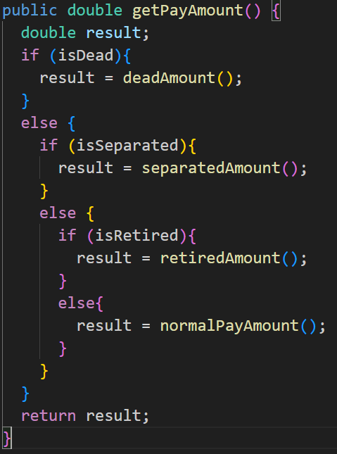

Replace Nested Conditional with Guard Clauses
Problem: You have a group of nested conditionals and it’s hard to determine the normal flow of code execution.
Solution: Isolate all special checks and edge cases into separate clauses and place them before the main checks. Ideally, you should have a “flat” list of conditionals, one after the other.

Slide 138

Replace Nested Conditional with Guard Clauses
Why Refactor?
Spotting the “conditional from hell” is fairly easy. The indentations of each level of nestedness form an arrow, pointing to the right in the direction of pain and woe:
It’s difficult to figure out what each conditional does and how, since the “normal” flow of code execution isn’t immediately obvious. These conditionals indicate helter-skelter evolution, with each condition added as a stopgap measure without any thought paid to optimizing the overall structure.
To simplify the situation, isolate the special cases into separate conditions that immediately end execution and return a null value if the guard clauses are true. In effect, your mission here is to make the structure flat.

Slide 139
Replace Nested Conditional with Guard Clauses
How to Refactor?
Try to rid the code of side effects—Separate Query from Modifier may be helpful for the purpose. This solution will be necessary for the reshuffling described below.
Isolate all guard clauses that lead to calling an exception or immediate return of a value from the method. Place these conditions at the beginning of the method.
After rearrangement is complete and all tests are successfully completed, see whether you can use Consolidate Conditional Expression for guard clauses that lead to the same exceptions or returned values.

Slide 140


Replace Conditional with Polymorphism
Problem: You have a conditional that performs various actions depending on object type or properties.
Solution: Create subclasses matching the branches of the conditional. In them, create a shared method and move code from the corresponding branch of the conditional to it. Then replace the conditional with the relevant method call. The result is that the proper implementation will be attained via polymorphism depending on the object class.

Slide 141
Replace Conditional with Polymorphism
Why Refactor?
This refactoring technique can help if your code contains operators performing various tasks that vary based on:
Class of the object or interface that it implements
Value of an object’s field
Result of calling one of an object’s methods
If a new object property or type appears, you will need to search for and add code in all similar conditionals. Thus, the benefit of this technique is multiplied if there are multiple conditionals scattered throughout all of an object’s methods.

Slide 142
Replace Conditional with Polymorphism
Benefits
This technique adheres to the Tell-Don’t-Ask principle: instead of asking an object about its state and then performing actions based on this, it’s much easier to simply tell the object what it needs to do and let it decide for itself how to do that.
Removes duplicate code. You get rid of many almost identical conditionals.
If you need to add a new execution variant, all you need to do is add a new subclass without touching the existing code (Open/Closed Principle).

Slide 143
Replace Conditional with Polymorphism
How to Refactor?
Preparing to Refactor
For this refactoring technique, you should have a ready hierarchy of classes that will contain alternative behaviors. If you don’t have a hierarchy like this, create one. Other techniques will help to make this happen:
Replace Type Code with Subclasses. Subclasses will be created for all values of a particular object property. This approach is simple but less flexible since you can’t create subclasses for the other properties of the object.
Replace Type Code with State/Strategy. A class will be dedicated for a particular object property and subclasses will be created from it for each value of the property. The current class will contain references to the objects of this type and delegate execution to them.

Slide 144
Replace Conditional with Polymorphism
Refactoring Steps
If the conditional is in a method that performs other actions as well, perform Extract Method.
For each hierarchy subclass, redefine the method that contains the conditional and copy the code of the corresponding conditional branch to that location.
Delete this branch from the conditional.
Repeat replacement until the conditional is empty. Then delete the conditional and declare the method abstract.

Slide 145


Introduce Null Object
Problem: Since some methods return null instead of real objects, you have many checks for null in your code.
Solution: Instead of null, return a null object that exhibits the default behavior.

Slide 146
Introduce Null Object
Why Refactor?
Dozens of checks for null make your code longer and uglier.
Drawbacks
The price of getting rid of conditionals is creating yet another new class.

Slide 147
Introduce Null Object
How to Refactor?
From the class in question, create a subclass that will perform the role of null object.
In both classes, create the method isNull(), which will return true for a null object and false for a real class.
Find all places where the code may return null instead of a real object. Change the code so that it returns a null object.
Find all places where the variables of the real class are compared with null. Replace these checks with a call for isNull().
If methods of the original class are run in these conditionals when a value doesn’t equal null, redefine these methods in the null class and insert the code from the else part of the condition there. Then you can delete the entire conditional and differing behavior will be implemented via polymorphism.
If things aren’t so simple and the methods can’t be redefined, see if you can simply extract the operators that were supposed to be performed in the case of a null value to new methods of the null object. Call these methods instead of the old code in else as the operations by default.

Slide 148


Introduce Assertion
Problem: For a portion of code to work correctly, certain conditions or values must be true.
Solution: Replace these assumptions with specific assertion checks.

Slide 149
Introduce Assertion
Why Refactor?
Say that a portion of code assumes something about, for example, the current condition of an object or value of a parameter or local variable. Usually, this assumption will always hold true except in the event of an error.
Make these assumptions obvious by adding corresponding assertions. As with type hinting in method parameters, these assertions can act as live documentation for your code.
As a guideline to see where your code needs assertions, check for comments that describe the conditions under which a particular method will work.

Slide 150
Introduce Assertion
Benefits
If an assumption isn’t true and the code therefore gives the wrong result, it’s better to stop execution before this causes fatal consequences and data corruption. This also means that you neglected to write a necessary test when devising ways to perform testing of the program.
Drawbacks
Sometimes an exception is more appropriate than a simple assertion. You can select the necessary class of the exception and let the remaining code handle it correctly.
When is an exception better than a simple assertion? If the exception can be caused by actions of the user or system and you can handle the exception. On the other hand, ordinary unnamed and unhandled exceptions are basically equivalent to simple assertions—you don’t handle them, and they’re caused exclusively as the result of a program bug that never should have occurred.

Slide 151
Introduce Assertion
How to Refactor?
When you see that a condition is assumed, add an assertion for this condition in order to make sure.
Adding the assertion shouldn’t change the program’s behavior.
Don’t overdo it with use of assertions for everything in your code. Check for only the conditions that are necessary for correct functioning of the code. If your code is working normally even when a particular assertion is false, you can safely remove the assertion.

Slide 152
Simplifying Method Calls
These techniques make method calls simpler and easier to understand. This, in turn, simplifies the interfaces for interaction between classes.
Techniques:
Rename Method
Add Parameter
Remove Parameter
Separate Query from Modifier
Parameterize Method
Replace Parameter with Explicit Methods
Preserve Whole Object
Replace Parameter with Method Call
Introduce Parameter Object
Remove Setting Method
Hide Method
Replace Constructor with Factory Method
Replace Error Code with Exception
Replace Error Code with Exception

Slide 153

Rename Method
Problem: The name of a method doesn’t explain what the method does.
Solution: Rename the method.

Slide 154
Rename Method
Why Refactor?
Perhaps a method was poorly named from the very beginning—for example, someone created the method in a rush and didn’t give proper care to naming it well.
Or perhaps the method was well named at first but as its functionality grew, the method name stopped being a good descriptor..
Benefits
Code readability. Try to give the new method a name that reflects what it does. Something like createOrder(), renderCustomerInfo(), etc.

Slide 155
Rename Method
How to Refactor?
See whether the method is defined in a superclass or subclass. If so, you must repeat all steps in these classes too.
The next method is important for maintaining the functionality of the program during the refactoring process. Create a new method with a new name. Copy the code of the old method to it. Delete all the code in the old method and, instead of it, insert a call for the new method.
Find all references to the old method and replace them with references to the new one.
Delete the old method. If the old method is part of a public interface, don’t perform this step. Instead, mark the old method as deprecated..

Slide 156

Add Parameter
Problem: A method doesn’t have enough data to perform certain actions.
Solution: Create a new parameter to pass the necessary data.

Slide 157
Add Parameter
Why Refactor?
You need to make changes to a method, and these changes require adding information or data that was previously not available to the method.
Benefits
The choice here is between adding a new parameter and adding a new private field that contains the data needed by the method. A parameter is preferable when you need some occasional or frequently changing data for which there’s no point in holding it in an object all of the time. In this case, the refactoring will pay off. Otherwise, add a private field and fill it with the necessary data before calling the method.
Drawbacks
Adding a new parameter is always easier than removing it, which is why parameter lists frequently balloon to grotesque sizes. This smell is known as the Long Parameter List.
If you need to add a new parameter, sometimes this means that your class doesn’t contain the necessary data, or the existing parameters don’t contain the necessary related data. In both cases, the best solution is to consider moving data to the main class or to other classes whose objects are already accessible from inside the method.

Slide 158
Add Parameter
How to Refactor?
See whether the method is defined in a superclass or subclass. If the method is present in them, you will need to repeat all the steps in these classes as well.
The following step is critical for keeping your program functional during the refactoring process. Create a new method by copying the old one and add the necessary parameter to it. Replace the code for the old method with a call to the new method. You can plug in any value to the new parameter (such as null for objects or a zero for numbers).
Find all references to the old method and replace them with references to the new method.
Delete the old method. Deletion isn’t possible if the old method is part of the public interface. If that’s the case, mark the old method as deprecated.

Slide 159

Remove Parameter
Problem: A parameter isn’t used in the body of a method.
Solution: Remove the unused parameter.

Slide 160
Remove Parameter
Why Refactor?
Every parameter in a method call forces the programmer reading it to figure out what information is found in this parameter. And if a parameter is entirely unused in the method body, this “noggin scratching” is for naught.
And in any case, additional parameters are extra code that must be run.
Sometimes we add parameters with an eye to the future, anticipating changes to the method for which the parameter might be needed. All the same, experience shows that it’s better to add a parameter only when it’s genuinely needed. After all, anticipated changes often remain
Benefits
A method contains only the parameters that it truly requires.
When Not to Use
If the method is implemented in different ways in subclasses or in a superclass, and your parameter is used in those implementations, leave the parameter as-is.

Slide 161
Remove Parameter
How to Refactor?
See whether the method is defined in a superclass or subclass. If so, is the parameter used there? If the parameter is used in one of these implementations, hold off on this refactoring technique.
The next step is important for keeping the program functional during the refactoring process. Create a new method by copying the old one and delete the relevant parameter from it. Replace the code of the old method with a call to the new one.
Find all references to the old method and replace them with references to the new method.
Delete the old method. Don’t perform this step if the old method is part of a public interface. In this case, mark the old method as deprecated.

Slide 162

Separate Query from Modifier
Problem: Do you have a method that returns a value but also changes something inside an object?
Solution: Split the method into two separate methods. As you would expect, one of them should return the value and the other one modifies the object.

Slide 163
Separate Query from Modifier
Why Refactor?
This factoring technique implements Command and Query Responsibility Segregation. This principle tells us to separate code responsible for getting data from code that changes something inside an object.
Code for getting data is named a query. Code for changing things in the visible state of an object is named a modifier. When a query and modifier are combined, you don’t have a way to get data without making changes to its condition. In other words, you ask a question and can change the answer even as it’s being received. This problem becomes even more severe when the person calling the query may not know about the method’s “side effects”, which often leads to runtime errors.
But remember that side effects are dangerous only in the case of modifiers that change the visible state of an object. These could be, for example, fields accessible from an object’s public interface, entry in a database, in files, etc. If a modifier only caches a complex operation and saves it within the private field of a class, it can hardly cause any side effects.

Slide 164
Separate Query from Modifier
Benefits
If you have a query that doesn’t change the state of your program, you can call it as many times as you like without having to worry about unintended changes in the result caused by the mere fact of you calling the method.
Drawbacks
In some cases, it’s convenient to get data after performing a command. For example, when deleting something from a database you want to know how many rows were deleted.

Slide 165
Separate Query from Modifier
How to Refactor?
Create a new query method to return what the original method did.
Change the original method so that it returns only the result of calling the new query method.
Replace all references to the original method with a call to the query method. Immediately before this line, place a call to the modifier method. This will save you from side effects in case if the original method was used in a condition of a conditional operator or loop.
Get rid of the value-returning code in the original method, which now has become a proper modifier method.

Slide 166

Parameterize Method
Problem: Multiple methods perform similar actions that are different only in their internal values, numbers or operations.
Solution: Combine these methods by using a parameter that will pass the necessary special value.

Slide 167
Parameterize Method
Why Refactor?
If you have similar methods, you probably have duplicate code, with all the consequences that this entails.
What’s more, if you need to add yet another version of this functionality, you will have to create yet another method. Instead, you could simply run the existing method with a different parameter.
Drawbacks
Sometimes this refactoring technique can be taken too far, resulting in a long and complicated common method instead of multiple simpler ones.
Also be careful when moving activation/deactivation of functionality to a parameter. This can eventually lead to creation of a large conditional operator that will need to be treated via Replace Parameter with Explicit Methods.

Slide 168
Parameterize Method
How to Refactor?
Create a new method with a parameter and move it to the code that’s the same for all classes, by applying Extract Method. Note that sometimes only a certain part of methods is actually the same. In this case, refactoring consists of extracting only the same part to a new method.
In the code of the new method, replace the special/differing value with a parameter.
For each old method, find the places where it’s called, replacing these calls with calls to the new method that include a parameter. Then delete the old method..

Slide 169


Replace Parameter with Explicit Methods
Problem: A method is split into parts, each of which is run depending on the value of a parameter.
Solution: Extract the individual parts of the method into their own methods and call them instead of the original method.

Slide 170
Replace Parameter with Explicit Methods
Why Refactor?
A method containing parameter-dependent variants has grown massive. Non-trivial code is run in each branch and new variants are added very rarely.
Benefits
Improves code readability. It’s much easier to understand the purpose of startEngine() than setValue("engineEnabled", true).
When Not to Use
Don’t replace a parameter with explicit methods if a method is rarely changed and new variants aren’t added inside it.

Slide 171
Replace Parameter with Explicit Methods
How to Refactor?
For each variant of the method, create a separate method. Run these methods based on the value of a parameter in the main method.
Find all places where the original method is called. In these places, place a call for one of the new parameter-dependent variants.
When no calls to the original method remain, delete it.

Slide 172

Preserve Whole Object
Problem: You get several values from an object and then pass them as parameters to a method.
Solution: Instead, try passing the whole object.

Slide 173
Preserve Whole Object
Why Refactor?
The problem is that each time before your method is called, the methods of the future parameter object must be called. If these methods or the quantity of data obtained for the method are changed, you will need to carefully find a dozen such places in the program and implement these changes in each of them.
After you apply this refactoring technique, the code for getting all necessary data will be stored in one place—the method itself.
Benefits
Instead of a hodgepodge of parameters, you see a single object with a comprehensible name.
If the method needs more data from an object, you won’t need to rewrite all the places where the method is used—merely inside the method itself.
Drawbacks
Sometimes this transformation causes a method to become less flexible: previously the method could get data from many different sources but now, because of refactoring, we’re limiting its use to only objects with a particular interface.

Slide 174
Preserve Whole Object
How to Refactor?
Create a parameter in the method for the object from which you can get the necessary values.
Now start removing the old parameters from the method one by one, replacing them with calls to the relevant methods of the parameter object. Test the program after each replacement of a parameter.
Delete the getter code from the parameter object that had preceded the method call.

Slide 175


Replace Parameter with Method Call
Problem: Calling a query method and passing its results as the parameters of another method, while that method could call the query directly.
Solution: Instead of passing the value through a parameter, try placing a query call inside the method body.

Slide 176
Replace Parameter with Method Call
Why Refactor?
A long list of parameters is hard to understand. In addition, calls to such methods often resemble a series of cascades, with winding and exhilarating value calculations that are hard to navigate yet have to be passed to the method. So, if a parameter value can be calculated with the help of a method, do this inside the method itself and get rid of the parameter.
Benefits
We get rid of unneeded parameters and simplify method calls. Such parameters are often created not for the project as it’s now, but with an eye for future needs that may never come.
Drawbacks
You may need the parameter tomorrow for other needs... making you rewrite the method.

Slide 177
Replace Parameter with Method Call
How to Refactor?
Make sure that the value-getting code doesn’t use parameters from the current method, since they’ll be unavailable from inside another method. If so, moving the code isn’t possible.
If the relevant code is more complicated than a single method or function call, use Extract Method to isolate this code in a new method and make the call simple.
In the code of the main method, replace all references to the parameter being replaced with calls to the method that gets the value.
Use Remove Parameter to eliminate the now-unused parameter.

Slide 178

Introduce Parameter Object
Problem: Your methods contain a repeating group of parameters.
Solution: Replace these parameters with an object.

Slide 179
Introduce Parameter Object
Why Refactor?
Identical groups of parameters are often encountered in multiple methods. This causes code duplication of both the parameters themselves and of related operations. By consolidating parameters in a single class, you can also move the methods for handling this data there as well, freeing the other methods from this code.
Benefits
More readable code. Instead of a hodgepodge of parameters, you see a single object with a comprehensible name.
Identical groups of parameters scattered here and there create their own kind of code duplication: while identical code isn’t being called, identical groups of parameters and arguments are constantly encountered.
Drawbacks
If you move only data to a new class and don’t plan to move any behaviors or related operations there, this begins to smell of a Data Class.

Slide 180
Introduce Parameter Object
How to Refactor?
Create a new class that will represent your group of parameters. Make the class immutable.
In the method that you want to refactor, use Add Parameter, which is where your parameter object will be passed. In all method calls, pass the object created from old method parameters to this parameter.
Now start deleting old parameters from the method one by one, replacing them in the code with fields of the parameter object. Test the program after each parameter replacement.
When done, see whether there’s any point in moving a part of the method (or sometimes even the whole method) to a parameter object class. If so, use Move Method or Extract Method.

Slide 181

Remove Setting Method
Problem: The value of a field should be set only when it’s created, and not change at any time after that.
Solution: So, remove methods that set the field’s value.

Slide 182
Remove Setting Method
Why Refactor?
You want to prevent any changes to the value of a field.
How to Refactor?
The value of a field should be changeable only in the constructor. If the constructor doesn’t contain a parameter for setting the value, add one.
Find all setter calls.
If a setter call is located right after a call for the constructor of the current class, move its argument to the constructor call and remove the setter.
Replace setter calls in the constructor with direct access to the field.
Delete the setter.

Slide 183

Hide Method
Problem: A method isn’t used by other classes or is used only inside its own class hierarchy.
Solution: Make the method private or protected.

Slide 184
Hide Method
Why Refactor?
Quite often, the need to hide methods for getting and setting values is due to development of a richer interface that provides additional behavior, especially if you started with a class that added little beyond mere data encapsulation.
As new behavior is built into the class, you may find that public getter and setter methods are no longer necessary and can be hidden. If you make getter or setter methods private and apply direct access to variables, you can delete the method.
Benefits
Hiding methods makes it easier for your code to evolve. When you change a private method, you only need to worry about how to not break the current class since you know that the method can’t be used anywhere else.
By making methods private, you underscore the importance of the public interface of the clss and of the methods that remain public.

Slide 185
Hide Method
How to Refactor?
Regularly try to find methods that can be made private. Static code analysis and good unit test coverage can offer a big leg up.
Make each method as private as possible.

Slide 186


Replace Constructor with Factory Method
Problem: You have a complex constructor that does something more than just setting parameter values in object fields.
Solution: Create a factory method and use it to replace constructor calls.

Slide 187
Replace Constructor with Factory Method
Why Refactor?
The most obvious reason for using this refactoring technique is related to Replace Type Code with Subclasses.
You have code in which an object was previously created, and the value of the coded type was passed to it. After use of the refactoring method, several subclasses have appeared and from them you need to create objects depending on the value of the coded type. Changing the original constructor to make it return subclass objects is impossible, so instead we create a static factory method that will return objects of the necessary classes, after which it replaces all calls to the original constructor.
Factory methods can be used in other situations as well, when constructors aren’t up to the task. They can be important when attempting to Change Value to Reference. They can also be used to set various creation modes that go beyond the number and types of parameters.

Slide 188
Replace Constructor with Factory Method
Benefits
A factory method doesn’t necessarily return an object of the class in which it was called. Often these could be its subclasses, selected based on the arguments given to the method.
A factory method can have a better name that describes what and how it returns what it does, for example Troops::GetCrew(myTank).
A factory method can return an already created object, unlike a constructor, which always creates a new instance.

Slide 189
Replace Constructor with Factory Method
How to Refactor?
Create a factory method. Place a call to the current constructor in it.
Replace all constructor calls with calls to the factory method.
Declare the constructor private.
Investigate the constructor code and try to isolate the code not directly related to constructing an object of the current class, moving such code to the factory method.

Slide 190


Replace Error Code with Exception
Problem: A method returns a special value that indicates an error?
Solution: Throw an exception instead.

Slide 191
Replace Error Code with Exception
Why Refactor?
Returning error codes is an obsolete holdover from procedural programming. In modern programming, error handling is performed by special classes, which are named exceptions. If a problem occurs, you “throw” an error, which is then “caught” by one of the exception handlers. Special error-handling code, which is ignored in normal conditions, is activated to respond.
Benefits
Frees code from a large number of conditionals for checking various error codes. Exception handlers are a much more succinct way to differentiate normal execution paths from abnormal ones.
Exception classes can implement their own methods, thus containing part of the error handling functionality (such as for sending error messages).
Unlike exceptions, error codes can’t be used in a constructor, since a constructor must return only a new object.

Slide 192
Replace Error Code with Exception
Drawbacks
An exception handler can turn into a goto-like crutch. Avoid this! Don’t use exceptions to manage code execution. Exceptions should be thrown only to inform of an error or critical situation.
How to Refactor?
Try to perform these refactoring steps for only one error code at a time. This will make it easier to keep all the important information in your head and avoid errors.
Find all calls to a method that returns error codes and, instead of checking for an error code, wrap it in try/catch blocks.
Inside the method, instead of returning an error code, throw an exception.
Change the method signature so that it contains information about the exception being thrown (@throws section).

Slide 193


Replace Exception with Test
Problem: You throw an exception in a place where a simple test would do the job?
Solution: Replace the exception with a condition test.

Slide 194
Replace Exception with Test
Why Refactor?
Exceptions should be used to handle irregular behavior related to an unexpected error. They shouldn’t serve as a replacement for testing. If an exception can be avoided by simply verifying a condition before running, then do so. Exceptions should be reserved for real errors.
For instance, you entered a minefield and triggered a mine there, resulting in an exception; the exception was successfully handled, and you were lifted through the air to safety beyond the mine field. But you could have avoided this all by simply reading the warning sign in front of the minefield to begin with.
Benefits
A simple conditional can sometimes be more obvious than exception handling code.

Slide 195
Replace Exception with Test
How to Refactor?
Create a conditional for an edge case and move it before the try/catch block.
Move code from the catch section inside this conditional.
In the catch section, place the code for throwing a usual unnamed exception and run all the tests.
If no exceptions were thrown during the tests, get rid of the try/catch operator.

Slide 196
Dealing with Generalization
Abstraction has its own group of refactoring techniques, primarily associated with moving functionality along the class inheritance hierarchy, creating new classes and interfaces, and replacing inheritance with delegation and vice versa.
Pull Up Field
Pull Up Method
Pull Up Constructor Body
Push Down Method
Push Down Field
Extract Subclass
Extract Superclass
Extract Interface
Collapse Hierarchy
Form Template Method
Replace Inheritance with Delegation
Replace Delegation with Inheritance

Slide 197

Pull Up Field
Problem: Two classes have the same field.
Solution: Remove the field from subclasses and move it to the superclass.

Slide 198
Pull Up Field
Why Refactor?
Subclasses grew and developed separately, causing identical (or nearly identical) fields and methods to appear.
Benefits
Eliminates duplication of fields in subclasses.
Eases subsequent relocation of duplicate methods, if they exist, from subclasses to a superclass.

Slide 199
Pull Up Field
How to Refactor?
Make sure that the fields are used for the same needs in subclasses.
If the fields have different names, give them the same name and replace all references to the fields in existing code.
Create a field with the same name in the superclass. Note that if the fields were private, the superclass field should be protected.
Remove the fields from the subclasses.
You may want to consider using Self Encapsulate Field for the new field, in order to hide it behind access methods.

Slide 200

Pull Up Method
Problem: Your subclasses have methods that perform similar work.
Solution: Make the methods identical and then move them to the relevant superclass.

Slide 201
Pull Up Method
Why Refactor?
Subclasses grew and developed independently of one another, causing identical (or nearly identical) fields and methods.
Benefits
Gets rid of duplicate code. If you need to make changes to a method, it’s better to do so in a single place than have to search for all duplicates of the method in subclasses.
This refactoring technique can also be used if, for some reason, a subclass redefines a superclass method but performs what’s essentially the same work.

Slide 202
Pull Up Method
How to Refactor?
Investigate similar methods in superclasses. If they aren’t identical, format them to match each other.
If methods use a different set of parameters, put the parameters in the form that you want to see in the superclass.
Copy the method to the superclass. Here you may find that the method code uses fields and methods that exist only in subclasses and therefore aren’t available in the superclass. To solve this, you can:
For fields: use either Pull Up Field or Self-Encapsulate Field to create getters and setters in subclasses; then declare these getters abstractly in the superclass.
For methods: use either Pull Up Method or declare abstract methods for them in the superclass (note that your class will become abstract if it wasn’t previously).
Remove the methods from the subclasses.
Check the locations in which the method is called. In some places you may be able to replace use of a subclass with the superclass.

Slide 203


Pull Up Constructor Body
Problem: Your subclasses have constructors with code that’s mostly identical.
Solution: Create a superclass constructor and move the code that’s the same in the subclasses to it. Call the superclass constructor in the subclass constructors.

Slide 204
Pull Up Constructor Body
Why Refactor?
How is this refactoring technique different from Pull Up Method?
In Java, subclasses can’t inherit a constructor, so you can’t simply apply Pull Up Method to the subclass constructor and delete it after removing all the constructor code to the superclass. In addition to creating a constructor in the superclass it’s necessary to have constructors in the subclasses with simple delegation to the superclass constructor.
In C++ and Java (if you didn’t explicitly call the superclass constructor) the superclass constructor is automatically called prior to the subclass constructor, which makes it necessary to move the common code only from the beginning of the subclass constructors (since you won’t be able to call the superclass constructor from an arbitrary place in a subclass constructor).
In most programming languages, a subclass constructor can have its own list of parameters different from the parameters of the superclass. Therefore, you should create a superclass constructor only with the parameters that it truly needs.

Slide 205
Pull Up Constructor Body
How to Refactor?
Create a constructor in a superclass.
Extract the common code from the beginning of the constructor of each subclass to the superclass constructor. Before doing so, try to move as much common code as possible to the beginning of the constructor.
Place the call for the superclass constructor in the first line in the subclass constructors.

Slide 206

Push Down Method
Problem: Is behavior implemented in a superclass used by only one (or a few) subclasses?
Solution: Move this behavior to the subclasses.

Slide 207
Push Down Method
Why Refactor?
At first a certain method was meant to be universal for all classes but is used in only one subclass. This situation can occur when planned features fail to materialize.
Such situations can also occur after partial extraction (or removal) of functionality from a class hierarchy, leaving a method that’s used in only one subclass.
If you see that a method is needed by more than one subclass, but not all of them, it may be useful to create an intermediate subclass and move the method to it. This allows avoiding the code duplication that would result from pushing a method down to all subclasses.
Benefits
Improves class coherence. A method is located where you expect to see it.

Slide 208
Push Down Method
How to Refactor?
Declare the method in a subclass and copy its code from the superclass.
Remove the method from the superclass.
Find all places where the method is used and verify that it’s called from the necessary subclass.

Slide 209

Push Down Field
Problem: Is a field used only in a few subclasses?
Solution: Move the field to these subclasses.

Slide 210
Push Down Field
Why Refactor?
Although it was planned to use a field universally for all classes, the field is used only in some subclasses. This situation can occur when planned features fail to pan out, for example.
This can also occur due to extraction (or removal) of part of the functionality of class hierarchies.
Benefits
Improves internal class coherency. A field is located where it’s actually used.
When moving to several subclasses simultaneously, you can develop the fields independently of each other. This does create code duplication, yes, so push down fields only when you really do intend to use the fields in different ways.

Slide 211
Push Down Field
How to Refactor?
Declare a field in all the necessary subclasses.
Remove the field from the superclass.

Slide 212

Extract Subclass
Problem: A class has features that are used only in certain cases.
Solution: Create a subclass and use it in these cases.

Slide 213
Extract Subclass
Why Refactor?
Your main class has methods and fields for implementing a certain rare use case for the class. While the case is rare, the class is responsible for it, and it would be wrong to move all the associated fields and methods to an entirely separate class. But they could be moved to a subclass, which is just what we’ll do with the help of this refactoring technique.
Benefits
Creates a subclass quickly and easily.
You can create several separate subclasses if your main class is currently implementing more than one such special case.

Slide 214
Extract Subclass
Drawbacks
Despite its seeming simplicity, Inheritance can lead to a dead end if you must separate several different class hierarchies. If, for example, you had the class Dogs with different behavior depending on the size and fur of dogs, you could tease out two hierarchies:
by size: Large, Medium and Small
by fur: Smooth and Shaggy
And everything would seem well, except that problems will crop up as soon as you need to create a dog that’s both Large and Smooth, since you can create an object from one class only. That said, you can avoid this problem by using Compose instead of Inherit (see the Strategy pattern). In other words, the Dog class will have two component fields, size and fur. You will plug in component objects from the necessary classes into these fields. So, you can create a Dog that has LargeSize and ShaggyFur.

Slide 215
Extract Subclass
How to Refactor?
Create a new subclass from the class of interest.
If you need additional data to create objects from a subclass, create a constructor and add the necessary parameters to it. Don’t forget to call the constructor’s parent implementation.
Find all calls to the constructor of the parent class. When the functionality of a subclass is necessary, replace the parent constructor with the subclass constructor.
Move the necessary methods and fields from the parent class to the subclass. Do this via Push Down Method and Push Down Field. It’s simpler to start by moving the methods first. This way, the fields remain accessible throughout the whole process: from the parent class prior to the move, and from the subclass itself after the move is complete.
After the subclass is ready, find all the old fields that controlled the choice of functionality. Delete these fields by using polymorphism to replace all the operators in which the fields had been used. A simple example: in the Car class, you had the field isElectricCar and, depending on it, in the refuel() method the car is either fueled up with gas or charged with electricity. Post-refactoring, the isElectricCar field is removed and the Car and ElectricCar classes will have their own implementations of the refuel() method.

Slide 216

Extract Superclass
Problem: You have two classes with common fields and methods.
Solution: Create a shared superclass for them and move all the identical fields and methods to it.

Slide 217
Extract Superclass
Why Refactor?
One type of code duplication occurs when two classes perform similar tasks in the same way or perform similar tasks in different ways. Objects offer a built-in mechanism for simplifying such situations via inheritance. But oftentimes this similarity remains unnoticed until classes are created, necessitating that an inheritance structure be created later.
Benefits
Code deduplication. Common fields and methods now “live” in one place only.
When Not to Use
You can not apply this technique to classes that already have a superclass.

Slide 218
Extract Superclass
How to Refactor?
Create an abstract superclass.
Use Pull Up Field, Pull Up Method, and Pull Up Constructor Body to move the common functionality to a superclass. Start with the fields, since in addition to the common fields you will need to move the fields that are used in the common methods.
Look for places in the client code where use of subclasses can be replaced with your new class (such as in type declarations).

Slide 219

Extract Interface
Problem: Multiple clients are using the same part of a class interface. Another case: part of the interface in two classes is the same.
Solution: Move this identical portion to its own interface.

Slide 220
Extract Interface
Why Refactor?
Interfaces are very apropos when classes play special roles in different situations. Use Extract Interface to explicitly indicate which role.
Another convenient case arises when you need to describe the operations that a class performs on its server. If it’s planned to eventually allow use of servers of multiple types, all servers must implement the interface.
Good to Know
There’s a certain resemblance between Extract Superclass and Extract Interface.
Extracting an interface allows isolating only common interfaces, not common code. In other words, if classes contain Duplicate Code, extracting the interface won’t help you to deduplicate.
All the same, this problem can be mitigated by applying Extract Class to move the behavior that contains the duplication to a separate component and delegating all the work to it. If the common behavior is large in size, you can always use Extract Superclass. This is even easier, of course, but remember that if you take this path, you will get only one parent class.

Slide 221
Extract Interface
How to Refactor?
Create an empty interface.
Declare common operations in the interface.
Declare the necessary classes as implementing the interface.
Change type declarations in the client code to use the new interface.

Slide 222

Collapse Hierarchy
Problem: You have a class hierarchy in which a subclass is practically the same as its superclass.
Solution: Merge the subclass and superclass.

Slide 223
Collapse Hierarchy
Why Refactor?
Your program has grown overtime and a subclass and superclass have become practically the same. A feature was removed from a subclass, a method was moved to the superclass... and now you have two look-alike classes.
Benefits
Program complexity is reduced. Fewer classes mean fewer things to keep straight in your head and fewer breakable moving parts to worry about during future code changes.
Navigating through your code is easier when methods are defined in one class early. You don’t need to comb through the entire hierarchy to find a particular method.

Slide 224
Collapse Hierarchy
When Not to Use
Does the class hierarchy that you’re refactoring have more than one subclass? If so, after refactoring is complete, the remaining subclasses should become the inheritors of the class in which the hierarchy was collapsed.
But keep in mind that this can lead to violations of the Liskov substitution principle. For example, if your program emulates city transport networks and you accidentally collapse the Transport superclass into the Car subclass, then the Plane class may become the inheritor of Car. Oops!

Slide 225
Collapse Hierarchy
How to Refactor?
Select which class is easier to remove: the superclass or its subclass.
Use Pull Up Field and Pull Up Method if you decide to get rid of the subclass. If you choose to eliminate the superclass, go for Push Down Field and Push Down Method.
Replace all uses of the class that you’re deleting with the class to which the fields and methods are to be migrated. Often this will be code for creating classes, variable and parameter typing, and documentation in code comments.
Delete the empty class.

Slide 226

Form Template Method
Problem: Your subclasses implement algorithms that contain similar steps in the same order.
Solution: Move the algorithm structure and identical steps to a superclass and leave implementation of the different steps in the subclasses.

Slide 227
Form Template Method
Why Refactor?
Subclasses are developed in parallel, sometimes by different people, which leads to code duplication, errors, and difficulties in code maintenance, since each change must be made in all subclasses.
Benefits
Code duplication doesn’t always refer to cases of simple copy/paste. Often duplication occurs at a higher level, such as when you have a method for sorting numbers and a method for sorting object collections that are differentiated only by the comparison of elements. Creating a template method eliminates this duplication by merging the shared algorithm steps in a superclass and leaving just the differences in the subclasses.
Forming a template method is an example of the Open/Closed Principle in action. When a new algorithm version appears, you need only to create a new subclass; no changes to existing code are required.

Slide 228
Form Template Method
How to Refactor?
Split algorithms in the subclasses into their constituent parts described in separate methods. Extract Method can help with this.
The resulting methods that are identical for all subclasses can be moved to a superclass via Pull Up Method.
The non-similar methods can be given consistent names via Rename Method.
Move the signatures of non-similar methods to a superclass as abstract ones by using Pull Up Method. Leave their implementations in the subclasses.
And finally, pull up the main method of the algorithm to the superclass. Now it should work with the method steps described in the superclass, both real and abstract.

Slide 229

Replace Inheritance with Delegation
Problem: You have a subclass that uses only a portion of the methods of its superclass (or it’s not possible to inherit superclass data).
Solution: Create a field and put a superclass object in it, delegate methods to the superclass object, and get rid of inheritance.

Slide 230
Replace Inheritance with Delegation
Why Refactor?
Replacing inheritance with composition can substantially improve class design if:
Your subclass violates the Liskov substitution principle, i.e., if inheritance was implemented only to combine common code but not because the subclass is an extension of the superclass.
The subclass uses only a portion of the methods of the superclass. In this case, it’s only a matter of time before someone calls a superclass method that he or she wasn’t supposed to call.
In essence, this refactoring technique splits both classes and makes the superclass the helper of the subclass, not its parent. Instead of inheriting all superclass methods, the subclass will have only the necessary methods for delegating to the methods of the superclass object.
Benefits
A class doesn’t contain any unneeded methods inherited from the superclass.
Various objects with various implementations can be put in the delegate field. In effect you get the Strategy design pattern

Slide 231
Replace Inheritance with Delegation
Drawbacks
You must write many simple delegating methods.
How to Refactor?
Create a field in the subclass for holding the superclass. During the initial stage, place the current object in it.
Change the subclass methods so that they use the superclass object instead of this.
For methods inherited from the superclass that are called in the client code, create simple delegating methods in the subclass.
Remove the inheritance declaration from the subclass.
Change the initialization code of the field in which the former superclass is stored by creating a new object.

Slide 232

Replace Delegation with Inheritance
Problem: A class contains many simple methods that delegate to all methods of another class.
Solution: Make the class a delegate inheritor, which makes the delegating methods unnecessary.

Slide 233
Replace Delegation with Inheritance
Why Refactor?
Delegation is a more flexible approach than inheritance, since it allows changing how delegation is implemented and placing other classes there as well. Nonetheless, delegation stops being beneficial if you delegate actions to only one class and all its public methods.
In such a case, if you replace delegation with inheritance, you cleanse the class of many delegating methods and spare yourself from needing to create them for each new delegate class method.
Benefits
Reduces code length. All these delegating methods are no longer necessary.

Slide 234
Replace Delegation with Inheritance
When Not to Use
Don’t use this technique if the class contains delegation to only a portion of the public methods of the delegate class. By doing so, you would violate the Liskov substitution principle.
This technique can be used only if the class still doesn’t have parents.

Slide 235
Replace Delegation with Inheritance
How to Refactor?
Make the class a subclass of the delegate class.
Place the current object in a field containing a reference to the delegate object.
Delete the methods with simple delegation one by one. If their names were different, use Rename Method to give all the methods a single name.
Replace all references to the delegate field with references to the current object.
Remove the delegate field.

